Slide 1
CS6456: Graduate Operating Systems
Brad Campbell – bradjc@virginia.edu
https://www.cs.virginia.edu/~bjc8c/class/cs6456-f19/

Slide 2
This week
Changing hardware: addition of nonvolatile memory
Changing applications: systems for machine learning
Changing capabilities: machine learning for systems

Slide 3

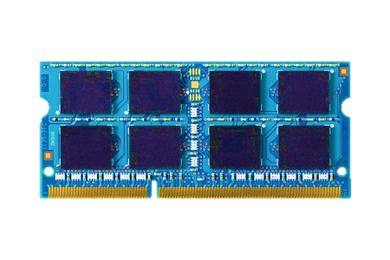

Two-level storage model
CPU
Ld/St
VOLATILE
MEMORY
FAST
DRAM
BYTE ADDR
FILE
I/O
STORAGE
NONVOLATILE
SLOW
BLOCK ADDR

Slide 4
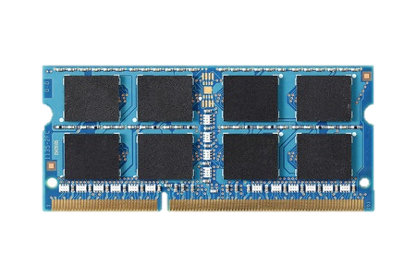
Two-level storage model
CPU
Ld/St
VOLATILE
MEMORY
FAST
DRAM
BYTE ADDR
FILE
I/O
NVM
STORAGE
PCM, STT-RAM
NONVOLATILE
SLOW
BLOCK ADDR
Non-volatile memories combine characteristics of memory and storage

Slide 5
Vision: Unify memory and storage
CPU
Ld/St
PERSISTENTMEMORY
NVM
Provides an opportunity to manipulate persistent data directly

Slide 6
DRAM is still faster
CPU
CPU
Ld/St
PERSISTENTMEMORY
MEMORY
DRAM
NVM
A hybrid unified
memory-storage system

Slide 7
Unify memory and storage
Opportunity to update data in-place in memory with Ld/St interface
Do not need to move data from disk to memory, translate file to data structure and transfer to disk again
Eliminates wasted work to locate, transfer, and translate data
Improves both energy and performance
Simplifies programming model as well

Slide 8
End-to-end system for persistent memory
PROBLEM
How to write consistent code?
CPU
How to allocate objects in persistent memory?
APPLICATION
Software
COMPILER
How to annotate and verify applications?
PERSISTENTMEMORY
Ld/St
PERSISTENT MANAGER
How to manage unified memory and storage support?
ARCHITECTURE
How to provide hardware support?
Hardware
CIRCUITS
How to reduce wear-out?
GOAL: A full stack support for persistent memory applications
Jinglei Ren+, “Dual-Scheme Checkpointing: A Software-Transparent Mechanism for Supporting Crash Consistency in Persistent Memory Systems”, MICRO 2015
Justin Meza+, “A Case for Efficient Hardware-Software Cooperative Management of Storage and Memory”, WEED 2013
Sihang Liu+, “Crash Consistency for Encrypted Non-Volatile Main Memory Systems”, HPCA 2018

Slide 9

NVMOVE: Helping Programmers Move to Byte-based Persistence
NVMOVE
Himanshu Chauhan
with
Irina Calciu, Vijay Chidambaram,
Eric Schkufza, Onur Mutlu, Pratap Subrahmanyam
Chauhan, H., Calciu, I., Chidambaram, V., Schkufza, E., Mutlu, O., & Subrahmanyam, P. (2016). NVMOVE: Helping Programmers Move to Byte-Based Persistence. INFLOW@OSDI.

Slide 10
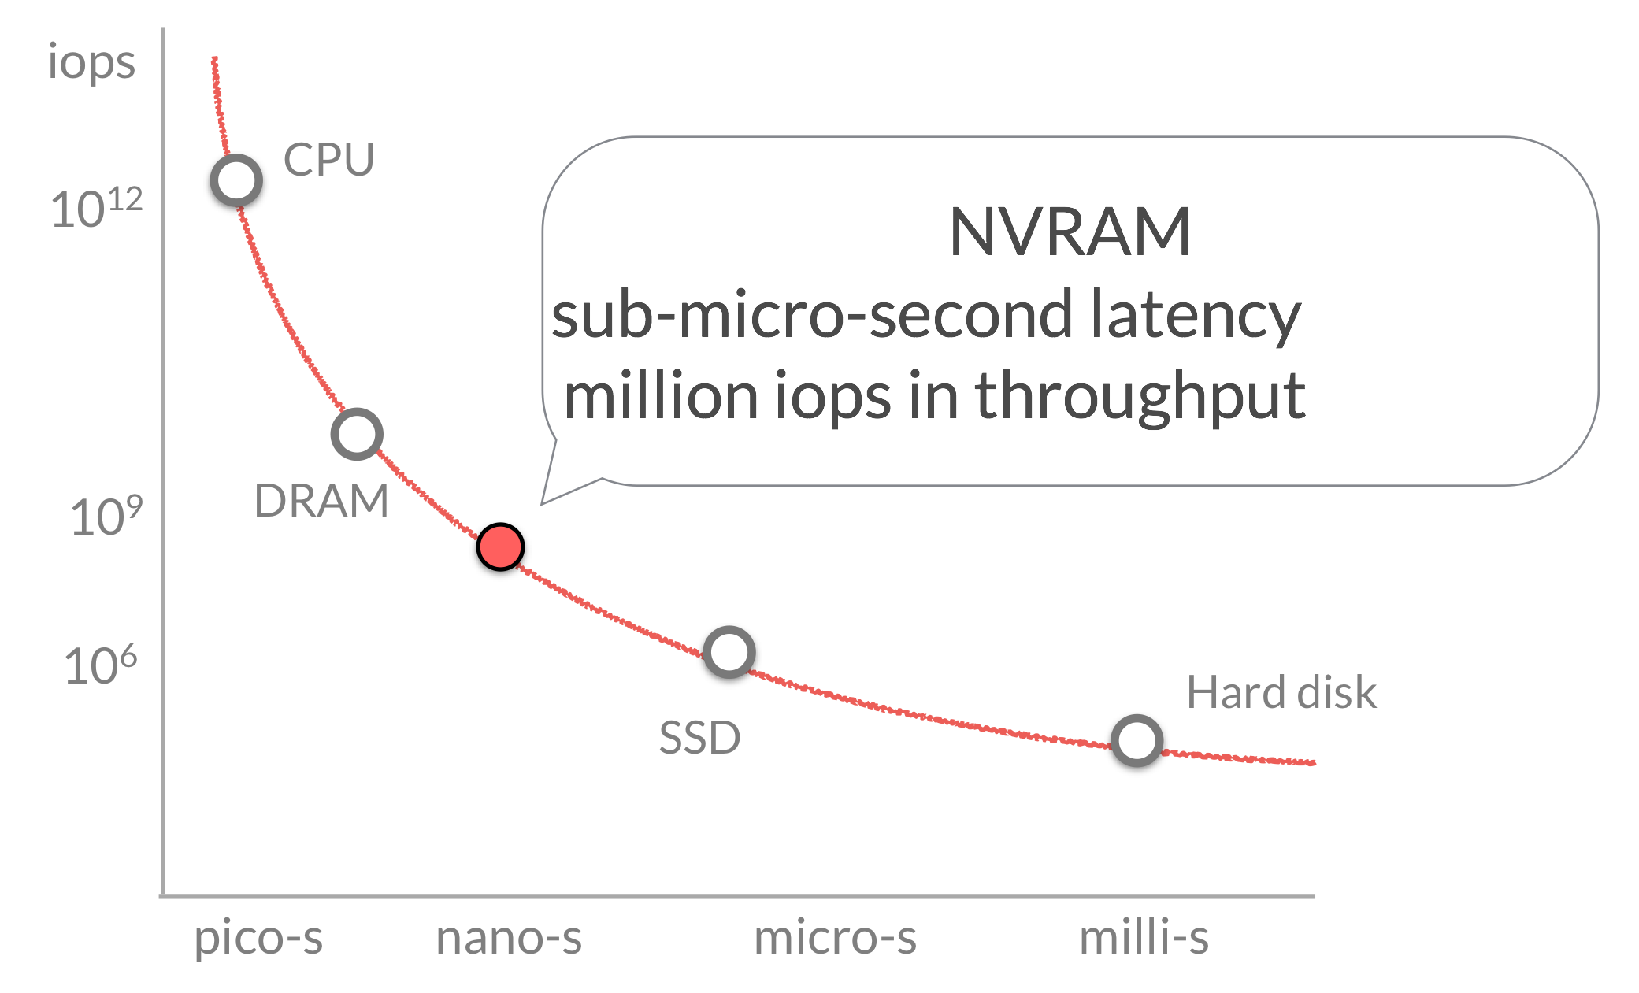
Fast, but volatile.
Cache
DRAM
SSD
Persistent, but slow.
Hard Disk
Notes:
In terms of throughput and latency, it sits roughly somewhere here. And thus has great potential for boosting performance of new applications.

Slide 11
Persistent Programs
typedef struct {
} node
1. allocate from memory
2. data read/write + program logic
3. save to storage
Notes:
Let us consider persistent prorgrams that save their state or data to storage.

Slide 12
Persistence Today
Notes:
Consider a binary search tree. If we want to persist it, we will have to perform these or very similar operations.

Slide 13
Persistence with NVM
Notes:
we know that this promise-land exists for programming new applications.
but what about exsiting persistent programs. how can we improve them to leverage nvm?

Slide 14

Changing Persistent Code
Present
NVM
/* allocate from volatile memory*/
node n* = malloc(sizeof(…))
/* allocate from non-volatile memory*/
node n* = pmalloc(sizeof(…))
node->value = val //volatile
update
…
node->value = val //persistent
update
…
/* persist to block-storage*/
char *buf= malloc(sizeof(…));
int fd = open("data.db",O_WRITE);
sprintf(buf,"…", node->id,
node->value);
write(fd, buf, sizeof(buf));
/* flush cache and commit*/
__cache_flush + __commit

Slide 15
Porting to NVM: Tedious
Identify data structures that should be on NVM
Update them in a consistent manner
Redis: simple key-value store (~50K LOC) - Industrial effort to port Redis is on-going after two years
- Open-source effort to port Redis has minimum functionality

Slide 16
Goal:
Port existing applications to NVM with minimal programmer involvement.

Slide 17

Requirement: find persistent types in source
User defined source types (structs in C)
that are persisted to block-storage.
Application Code
Block Storage

Slide 18

Application Code
write system call
Block Storage

Slide 19
node *n = malloc(sizeof(node))
node
iter *it = malloc(sizeof(iter))
/* persist to block-storage*/
char *buf= malloc(…))
int fd = open(…)
sprintf(buf,”…”,node->value)
write(fd, buf, …)
write system call

Slide 20
node
/* write to network socket*/
…
write(socket, “404”, …)
/* write to error stream*/
…
write(stderr, “All is lost.”, …)
/* persist to block-storage*/
…
write(fd, buf, …)
write system call
Pipe
Storage
Network

Slide 21

node
Save to block-storage
Load/recover
Block Storage

Slide 22
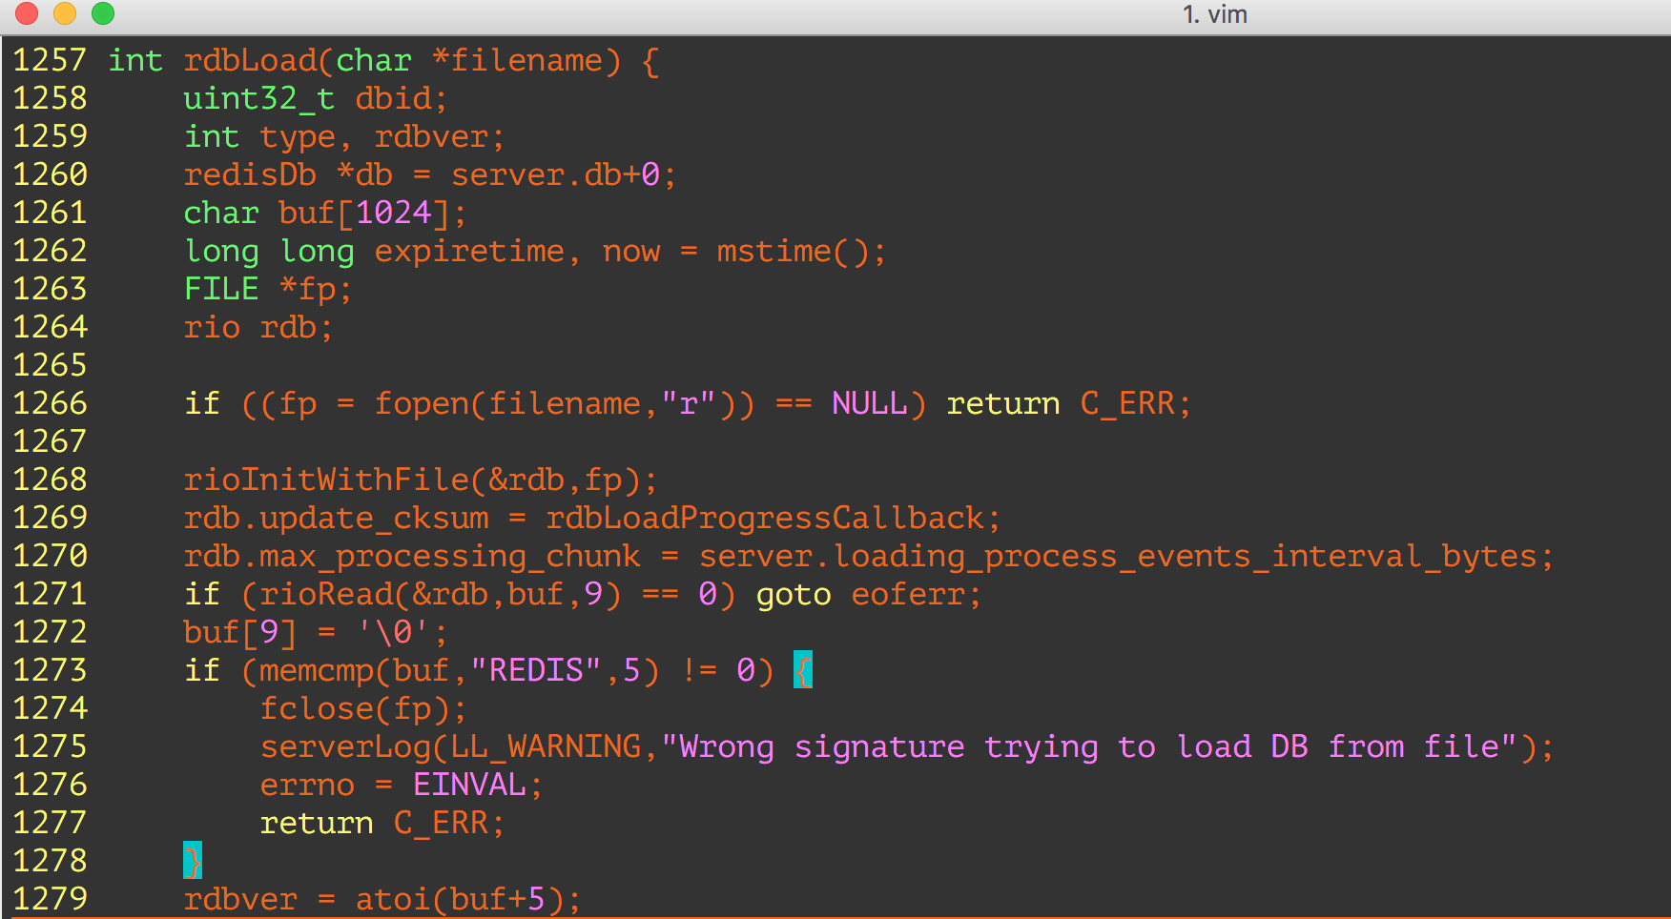

“rdbLoad” is the load/recovery function.

Slide 23
Mark every type that can be created during the recovery.
rdbLoad
external
library

Slide 24
Search the call graph to find types
Application type created/modified
external
library

Slide 25

Evaluation: redis
In-memory data structure store
strings, hashes, lists, sets, indexes
Persistence
— data-snapshots(RDB),
— command-logging (AOF)
~50K lines-of-code

Slide 26
Identification Accuracy
122 types (structs) in Redis Source
Notes:
fortunately for us, an industrial team has already gone thru the painful and laborious process of manually porting redis to nvm. So all we had to do was to ask them for the list of types that they make persistent in their implementaiton.

Slide 27
Identification Accuracy

Slide 28
Identification Accuracy
Total types: 122
NVMOVE identified persistent types 25
True positives (manually identified) 14
False positives 11
False negatives 0

Slide 29
YCSB Benchmark Results
write-heavy (90% update, 10% read)
27K ops/s
in-memory (=1.0)
Possible Data loss
111 MB
Fraction of
in-memory
throughput

Slide 30


Slide 31



Log-Structured Non-Volatile Main Memory
Qingda Hu*, Jinglei Ren, Anirudh Badam, and Thomas Moscibroda Microsoft Research *Tsinghua University

Slide 32


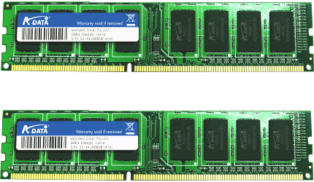
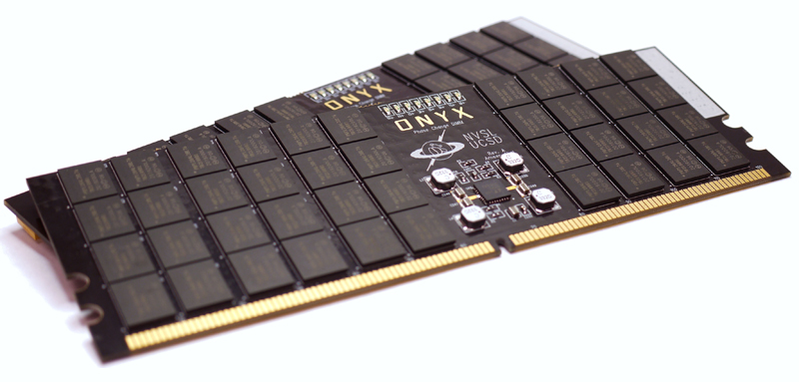
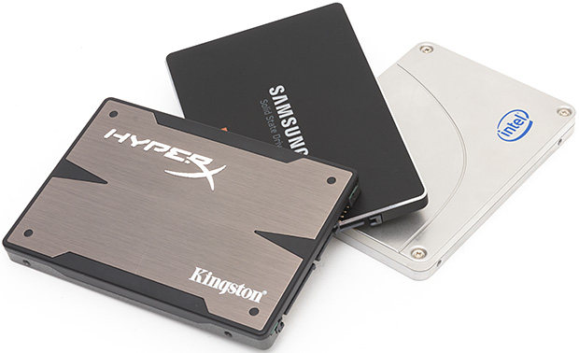
Non-volatile memory is coming…
Data storage
3D XPoint/Optane (2015 - )
Read: ~50ns
Write: ~10GB/s
PCM
Read: ~100ns
Write: ~1GB/s
Read: ~10µs
Write: ~100MB/s

Slide 33



Background: Impact of NVM
Architecture:
Data persistence as a bottleneck
➔ 10+x application performance improvement
Non-Volatile Main Memory (NVMM)
DRAM
DRAM
NVM
SSD

Slide 34
Executive Summary
Motivation
Solution: Log-structured memory management for NVMM.
Evaluation: 7x less memory waste; 90% higher write throughput.
Application
Application
Library
Library
Inefficient use of memory space
DRAM
NVMM
Inefficient support for crash consistency
SSD

Slide 35
Outline
Motivation
Log-Structured NVMM
Tree-Based Address Mapping
Evaluation

Slide 36
Why not just use existing techniques for memory management and filesystems?
Inefficient use of memory space
Reason: Traditional DRAM allocators incur high memory fragmentation.
Explanation:
Internal fragmentation:
External fragmentation:
8B
16B
…
8B | 8B | 8B | 8B | 8B | … | 8B | 8B
……
16B | 16B | … | 16B
……
…
……
32B
24B
Waste
64B request
32B | Waste (32B) | 32B | 32B | Waste (32B)

Slide 37
Motivation I
Inefficient use of memory space (cont.)
Fragmentation is a more severe issue for NVM as the process state is maintained, and not temporary.
process
process
process
process
process
process
DRAM
NVMM
Notes:
For NVM, fragmentation is a more severe issue. DRAM can accept a reasonable level of fragmentation because data occupation tends to be temporary.
It is OK to waste some space for a short while. But for NVM, data occupation is supposed to be permanent.

Slide 38
Motivation II
Inefficient support for crash consistency
Reason: Write-twice in log and home.
Explanation: Redo logging for example.
transaction {
a += 1;
b -= 1;
}
NVMM
Home
a
b
Log
a’
b’
Notes:
If the transaction is interrupted by a crash, it must either roll back to the beginning state, or roll forward to the end state. To maintain such crash consistency, we cannot directly update A and B in-place.
Instead, we have to first log the new values in a special logging area.
Only after that, we update A and B in-place. Suppose the transaction is crashed. We can roll forward the transaction using the new values in the log. So, there is nothing wrong with crash consistency. But we can see that A and B are both written twice, once in the log, and once in the home. Such write-twice behavior largely reduces the write throughput of NVM and increases its wear-out. Wear-out is also critical for NVM because its endurance is limited.

Slide 39
Outline
Motivation
Log-Structured NVMM
Tree-Based Address Mapping
Evaluation

Slide 40
Log-Structured NVMM
Library and architecture
Process (user space)
Address mapping (DRAM)
Transaction
Home addr. | Log addr.
&a
&b | …
translate(&a)
a
a’
Allocated | Available
a
Memory management: An append-only log
mmap()
 | Application X
NVM device
Notes:
The log-structured NVMM is a user-space library by which applications can allocate or free NVM space and access NVM data through transactions.
This library manages part of the physical NVM that is assigned to a certain application. We assume OS decides which NVM part is assigned. Our library just maps whatever given NVM to the process memory space.
Then, the whole NVM space is organized as a large append-only log. There is no separate log and home areas.
When there is an allocation or write, the new data is always added to the end of the log.
An address translation mechanism translates an address in application view to the real address in the log. So, every NVM access has to call an address translate function. Internally, our library maintains an address mapping structure to perform the translation. In our system, we put address mappings in DRAM for better performance. If the address mappings are lost due to a crash, they can be rebuilt from the log. So, access or update to address mappings does not involve NVM.

Slide 41
Log-Structured NVMM
Low fragmentation
For internal fragmentation: Compact append
For external fragmentation: Log cleaning
Allocated | Available
a
No internal fragmentation
Allocated | Available
a
a’
Notes:
For memory fragmentation, we completely avoid internal fragmentation because all data is compactly appended to the log. There is just no fragment between them.
Meanwhile, external fragmentation still exists. For example, suppose A is updated and the new value is appended to the log. Then the old value is free, making a fragment. We deal with such external fragmentation by log cleaning. Here is what we do.
The huge log physically consists of a linked list of chunks. Periodically, we scan some chunks and collect valid data to a new chunk.
Then, the original chunks can be reused. So, fragments are gone. After those data movements, we need to update the address mappings accordingly. Essentially, it is the address mapping facility that enables removal of external fragmentation. Overall, our library can effectively overcome the fragmentation issue and reduce memory waste.

Slide 42
Log-Structured NVMM
Efficient crash-consistent update
No separate areas. Write only once.
Header: size, checksum, etc.
transaction {
a += 1;
b -= 1;
}
Address mapping
Home addr. | Log addr.
&a
&b
a
b
a’
b’
Allocated | Available
Notes:
For the second problem, maintaining crash consistency, we no longer need to write data twice, because we don't have separate log and home areas. The whole NVM is just a log.
Take the transaction for example. Initially, A and B are mapped to some addresses in the log. To update them, we append their new values to the log along with some metadata. The metadata includes a checksum of the new values. Suppose a crash interrupts the transaction. We can verify the checksum on recovery. If it is invalid, we simply truncate the log and discard new values. In this way, we write A and B only once but still guarantees crash consistency. In most cases, we can save a significant amount of write traffic, leading to high throughput and low wear-out. In summary, the log-structured approach solves the two problems. But applying it to the main memory is not as easy as it sounds.

Slide 43
Outline
Motivation
Log-Structured NVMM
Tree-Based Address Mapping
Evaluation

Slide 44
Tree-Based Address Mapping
Unique challenges to NVMM
Pervasive and highly frequent memory accesses.
Allocation granularity ≠ access granularity ➔ No O(1) lookup.
Filesystems: hash(block number) as the index.
Databases: hash(key or tuple ID) as the index.
Main memory: hash(address)? That maps every address!
Tree-based mapping made performant.
0xABB4, size=16
? 0xABC8
0xABC0, size=24
...
Notes:
Although the log-structured approach has been used in filesystems and databases. NVM brings two unique challenges.
First, every NVM access needs address translation, so the frequency is very high, orders of magnitude higher than disk I/Os. That requries very high performance of address translation.
Second, in main memory, the allocation granularity is not equivalent to the access granularity. That means we cannot directly use O(1) data structures like hash table to do the address mapping. In main memory, an application can allocate an area at some address, but access any arbitrary address in that area. So, which address should we use to index that area? Definitely, we cannot map every memory address.
Therefore, the only viable way to map memory addresses is to use a tree data structure. In such a tree, each node holds the starting address and the size of an allocated area. We only need to index the staring address of an allocated area. Different from hash table, a tree maintains the order of indexed addresses. So we can find nearby addresses. For example, an application allocates a 24B area at the address 0xABC0. If the application queries the address 0xABC8, we can go down the tree and find the node 0xABC0 that contains the target address. So, a tree enables using the allocation granularity to serve arbitrary access.
In summary, we need a tree structure for address mapping and the tree has to be very performant.

Slide 45
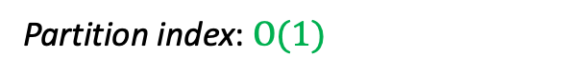
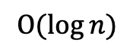
Tree-Based Address Mapping
Two-layer mapping
Partition index: $Ο(1)$
……
……
……
Tree for a small
partition (4KB)
$$Ο(\log{n})$$
Improves transaction throughput by 39.6% on average.
Notes:
We designed four techniques to achieve good enough performance. The first one is two-layer mapping.
The height of a tree determines the average tree operation overhead, so we cut the tree. Particularly, we divide the NVM space into fixed-length partitions, so just O(1) cycles are necessary to find the partition for an address. This is the first layer of mapping.
Then, for each partition, we use a small tree as the second-layer mapping. Since the partition size is very small, typically 4KB, such a partition-local tree has a largely reduced height.
According to our evaluation with various workloads, this optimization improves transaction throughput by almost 40% on average.

Slide 46
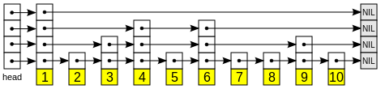
Tree-Based Address Mapping
Skip list
……
A probabilistically balanced tree. No complex balancing operations ➔ No locking for read-only operations.
Improves transaction throughput by 48.9% with four threads.
Notes:
The second optimization is using the skip list for the tree. A problem with a regular strictly balanced tree like a B-tree is that it requires complex tree balancing operations. As a result, every access to the tree has to hold a lock, which easily becomes the bottleneck.
In contrast, the skip list is a probabilistic tree structure without balancing operations. A skip list consists of several singly linked lists of nodes to form a tree structure. I don't go to details here but what we can achieve is lock-free lookup operations.
Our observation is that avoiding lock for very frequent lookup operations improves the transaction throughput by almost 50% with four threads.

Slide 47
Tree-Based Address Mapping
Group update
Within each transaction, all writes are first buffered in DRAM.
Writes with contiguous addresses are combined on transaction commit.
Improves transaction throughput by 42.3% on average.

Slide 48
Tree-Based Address Mapping
Hot tree node cache
A thread-local cache that references recently accessed nodes of the trees.
A special hash table design: Deliberately high collision.
Motivation: Addresses within a cached node are not hit due to random distribution of their hash values.
Solution: Use high-order bits of an address as its hash value.
Improves transaction throughput by 30.1% on average.
0xABB*
0xABC*
0xABD*
0xABC00 (size=24)
0xABCD0 (size=16)
? 0xABC08
Collison and found!
Notes:
Finally, the fourth optimization is hot tree node cache. It is a thread-local hash table that stores references to recently accessed tree nodes.
We make a special design for this hash table. Regularly, we don't want collision in a hash table. But in this case, we deliberately increase the collision. Recall the reason why we need a tree structure instead of a hash table for address mapping. It is the same problem here. Addresses nearby a cached address are not hit in a regular hash table.
So, we came up with a simple solution: use high-order bits of an address as its hash value. Nearby addresses of a cached address tend to be a collision and encounter the cached node. Overall, the tree node cache improves transaction throughput by over 30% on average.

Slide 49
Outline
Motivation
Log-Structured NVMM
Tree-Based Address Mapping
Evaluation

Slide 50
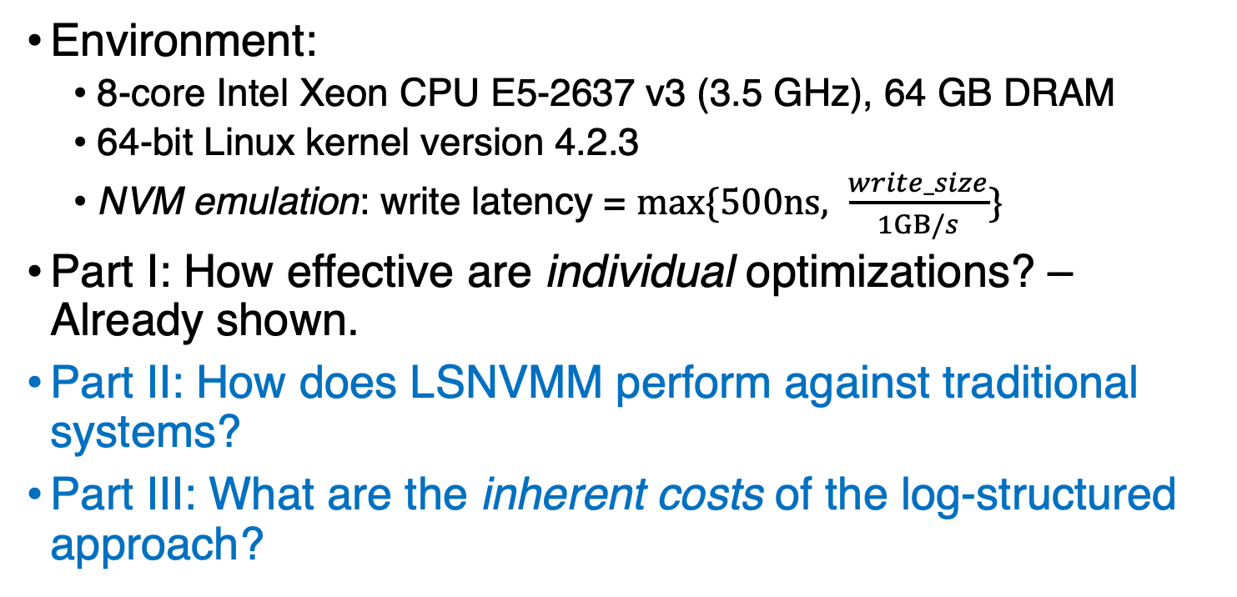
Evaluation
Environment:
8-core Intel Xeon CPU E5-2637 v3 (3.5 GHz), 64 GB DRAM
64-bit Linux kernel version 4.2.3
NVM emulation: write latency = $max⁡\{500ns, \frac{write_size}{1GB/s}\}$
Part I: How effective are individual optimizations? – Already shown.
Part II: How does LSNVMM perform against traditional systems?
Part III: What are the inherent costs of the log-structured approach?

Slide 51
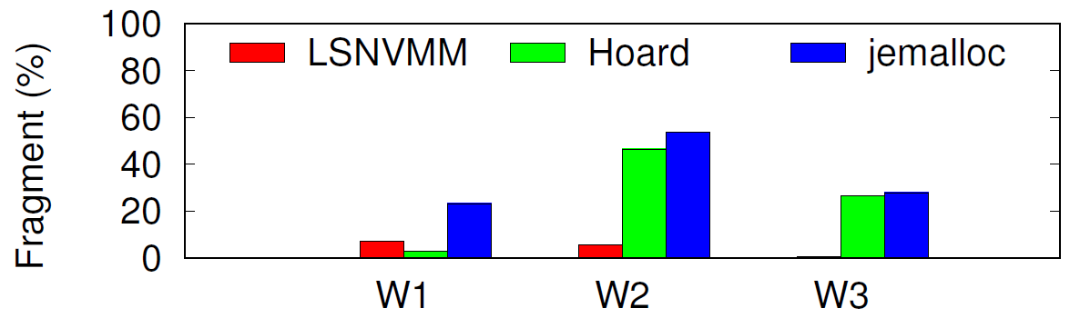
Evaluation
Fragmentation: Compared to Hoard and jemalloc
Workloads 1 ~ 3 collected from [S. Rumble, FAST ’14].
Hoard/jemalloc produces 25.3%/35.0% fragmentation on average.
Log-structured NVM (LSNVMM) produces 4.5% fragmentation on average.

Slide 52
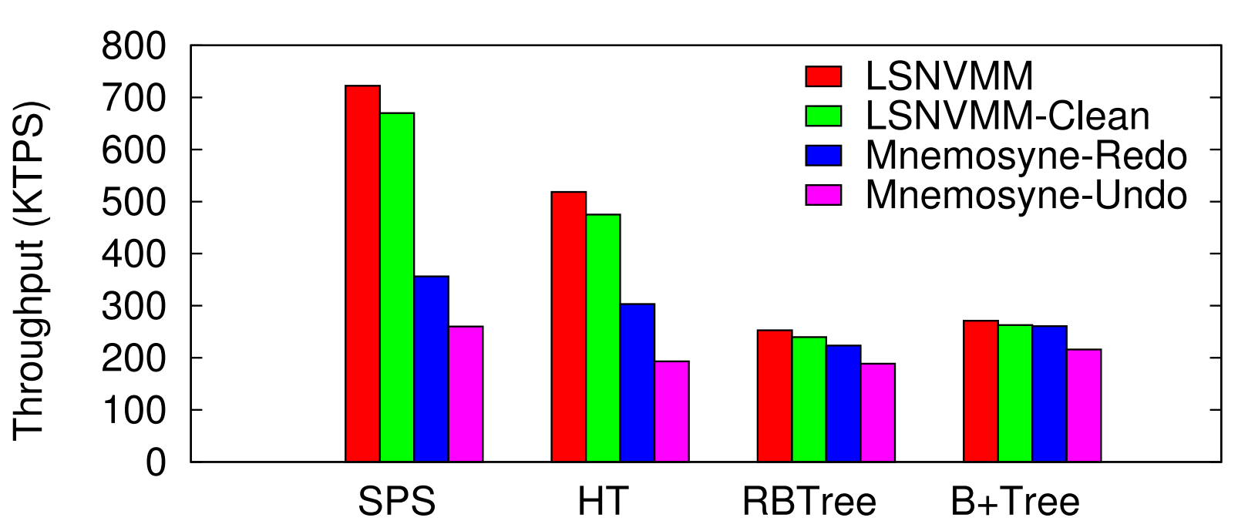
Evaluation
Transaction throughput compared to Mnemosyne
With 4 threads, log-structured NVMM performs 44.7% and 80.8% better than Mnemosyne and Mnemosyne-Undo, respectively, on average.

Slide 53
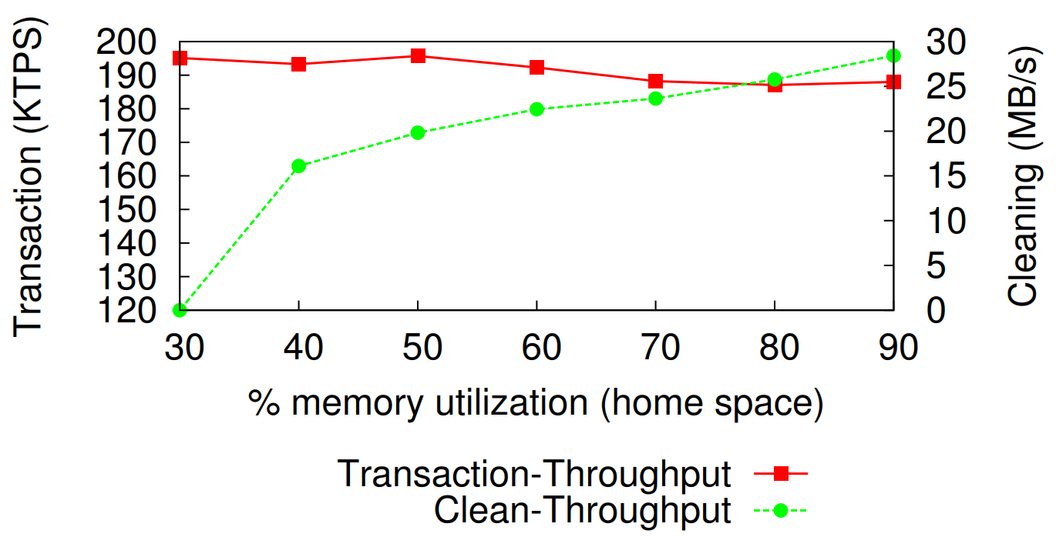
Evaluation
Cost of log cleaning
The performance degradation due to log cleaning is 8% at 90% memory utilization.

Slide 54
Conclusion
Takeaway I: Applying the log-structured approach to NVMM can largely reduce memory fragmentation and improve system performance.
Takeaway II: A tree-based address mapping mechanism can be made efficient to serve log-structured NVMM.

Slide 55
OS + Machine Learning

Slide 56
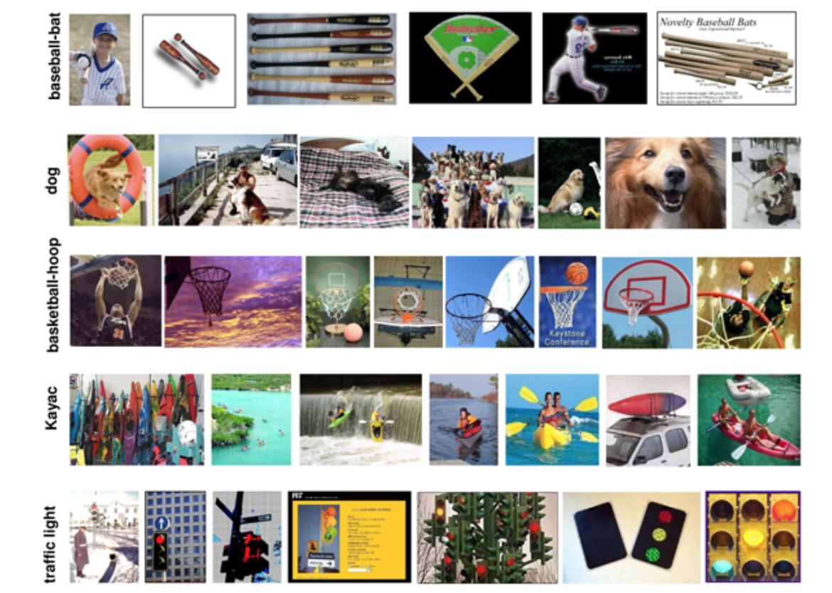
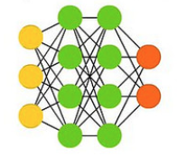
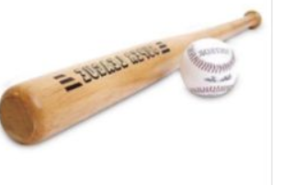
Background: Machine Learning
images, labels = train_data_load()
model = NeuralNetwork()
model.train(images, labels)
new_label = model.inference(new_image)
Training
Training set¹
Baseball-bat
Model
1 Caltech-256 dataset

Slide 57
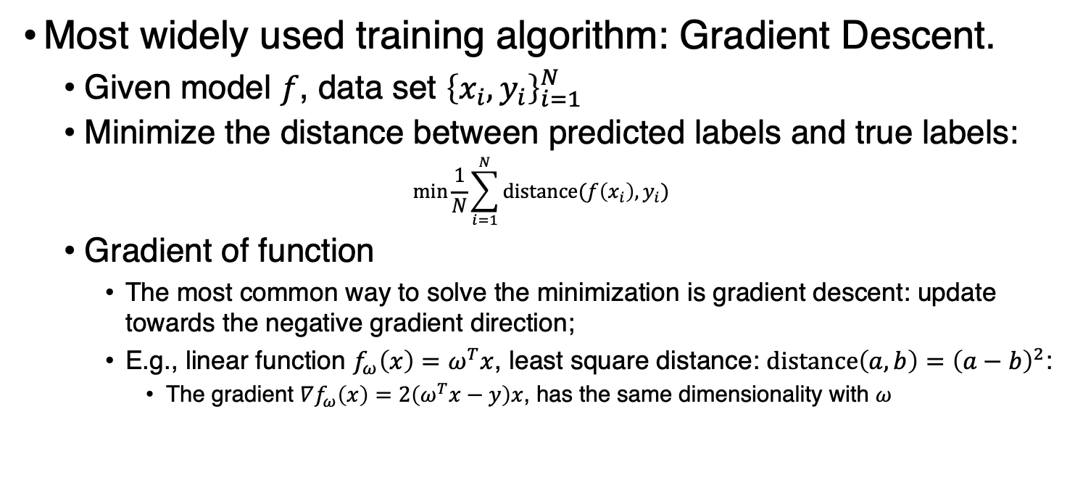
Background: Machine Learning
Most widely used training algorithm: Gradient Descent.
Given model $f$, data set ${\left\{x_{i}, y_{i}\right\}}_{i=1}^{N}$
Minimize the distance between predicted labels and true labels:
$$\min{\frac{1}{N}\sum_{i=1}^{N}{distance(f\left(x_{i}\right), y_{i})} }$$
Gradient of function
The most common way to solve the minimization is gradient descent: update towards the negative gradient direction;
E.g., linear function $f_{ω}\left(x\right)=ω^{T}x$, least square distance: $distance\left(a, b\right)={\left(a−b\right)}^{2}$:
The gradient $∇f_{ω}\left(x\right)=2\left(ω^{T}x−y\right)x$, has the same dimensionality with $ω$

Slide 58
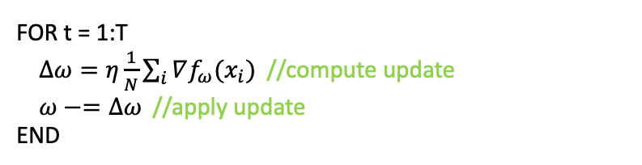
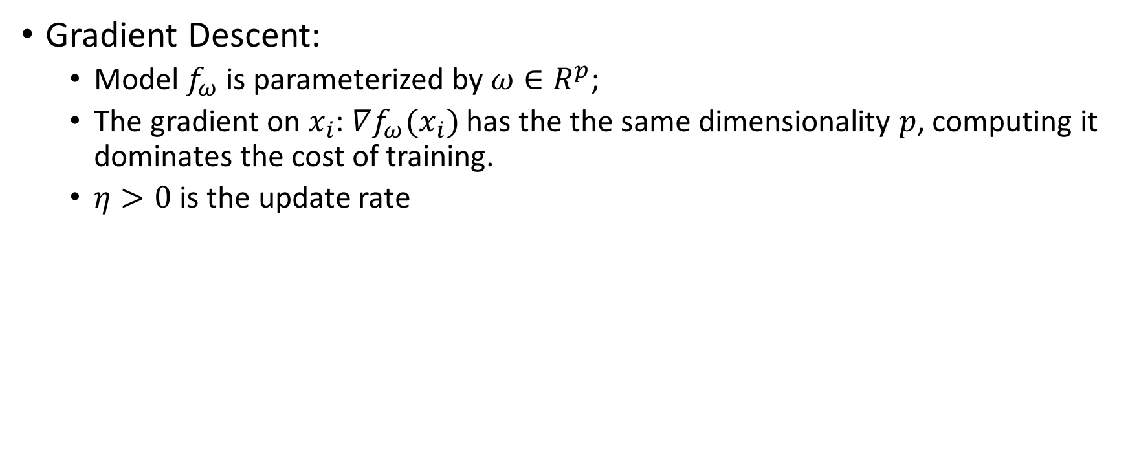
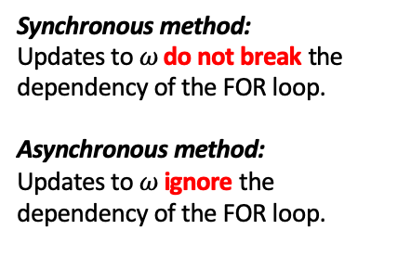
Background: Machine Learning
Gradient Descent:
Model $f_{ω}$ is parameterized by $ω∈R^{p}$;
The gradient on $x_{i}$: $∇f_{ω}(x_{i})$ has the the same dimensionality $p$, computing it dominates the cost of training.
$η>0$ is the update rate
Can be parallelized
Synchronous method:
Updates to $ω$ do not break the dependency of the FOR loop.
Asynchronous method:
Updates to $ω$ ignore the dependency of the FOR loop.
FOR t = 1:T
$Δω=η\frac{1}{N}\sum_{i}{∇f_{ω}(x_{i})}$ //compute update
$ω−=Δω$ //apply update
END

Slide 59

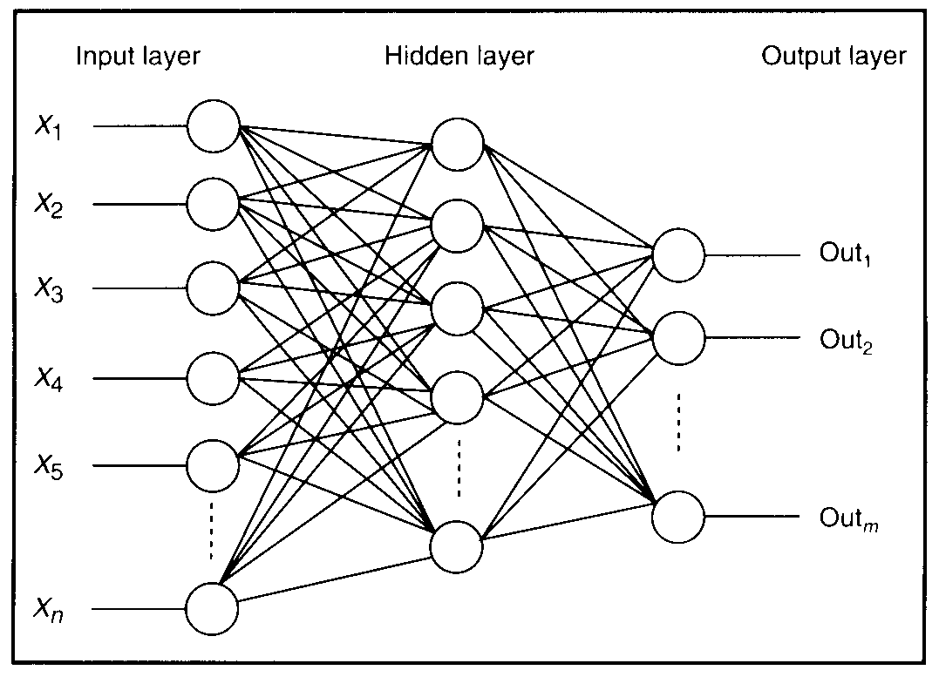
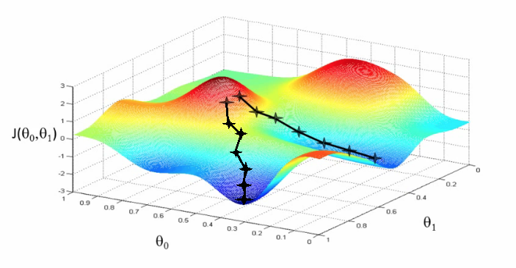
Background: NN Training
Process:
Take input image
Compute loss function (forward pass)
Compute error gradients (backward pass)
Update weights
Repeat
Problem:
Training process is usually time consuming, especially when training set / model size is large

Slide 60
Looking at: Systems to answer…
How to create ML models
How to create ML models even faster
How to check if ML models are any good

Slide 61



Is running or training ML an OS problem?
SOSP = Symposium on Operating System Principles OSDI = Operating System Design and Implementation

Slide 62
TensorFlow: A System for Large-Scale Machine Learning
Martín Abadi, Paul Barham, Jianmin Chen, Zhifeng Chen, Andy Davis, Jeffrey Dean,
Matthieu Devin, Sanjay Ghemawat, Geoffrey Irving, Michael Isard, Manjunath Kudlur,
Josh Levenberg, Rajat Monga, Sherry Moore, Derek G. Murray, Benoit Steiner, Paul Tucker,
Vijay Vasudevan, Pete Warden, Martin Wicke, Yuan Yu, and Xiaoqiang Zheng, Google Brain
12th USENIX Symposium on Operating Systems Design and Implementation (OSDI ’16)

Slide 63
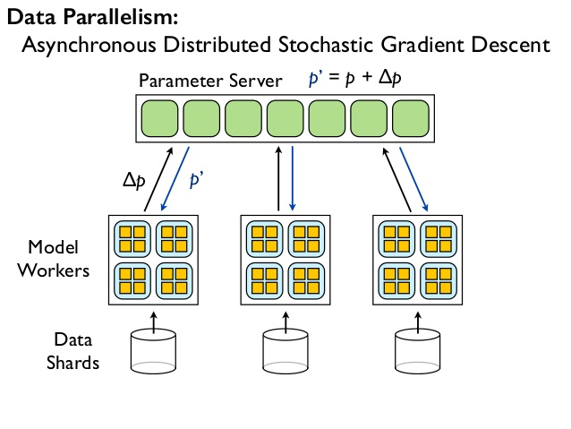
Background: Dist Belief, parameter-server arch
Jeffrey Dean, Greg S. Corrado, Rajat Monga, Kai Chen, Matthieu Devin, Quoc V. Le, Mark Z. Mao, Marc'Aurelio Ranzato, Andrew Senior, Paul Tucker, Ke Yang, and Andrew Y. Ng. 2012. Large scale distributed deep networks. NeurIPS’12.
Notes:
PSA:
two disjoint sets of processes:
stateless worker processes that perform the bulk of the computation when training a model
stateful parameter server processes that maintain the current version of the model parameters.
The user defines a neural network as a DAG of layers that terminates with a loss function.
A layer is a composition of mathematical operators:
for example, a fully connected layer multiplies its input by a weight matrix
adds a bias vector, and applies a non-linear function (such as a sigmoid) to the result.
A loss function is a scalar function that quantifies the difference between the predicted value (for a given input data point) and the ground truth.
In a fully connected layer, the weight matrix and bias vector are parameters, which a learning algorithm will update in order to minimize the value of the loss function.
DistBelief uses the DAG structure and knowledge of the layers’ semantics to compute gradients for each of the model parameters, via backpropagation [63].
Because the parameter updates in many algorithms are commutative and have weak consistency requirements [61], the worker processes can compute updates independently and write back “delta” updates to each parameter server, which combines the updates with its current state.

Slide 64
Background: Shortcomings of DistBelief
Difficulty of implementing new layers
C++ classes implement layers
Configuration file defines DNN architecture
Not flexible enough for researchers
Refining Algorithms
SGD is the heart of the training -- finalized in the parameter server
Need atomicity for some techniques -- get/put interface cannot accommodate
Supporting new algorithms
If it doesn’t conform to feed-forward, it doesn’t map well to DistBelief (EM, RF, RL, AdvMl)
Scaling down to other environments
Designed to run on distributed cluster of multi-cores
Augmented for GPGPU support for Conv NN
Notes:
Defining new layers For efficiency, we implemented DistBelief layers as C++ classes. Using a separate, less familiar programming language for implementing layers is a barrier for machine learning researchers who seek to experiment with new layer architectures, such as sampled softmax classifiers [37] and attention modules [53].
Refining the training algorithms Many neural networks are trained using stochastic gradient descent (SGD), which iteratively refines the parameters of the network by moving them in the direction that maximally decreases the value of the loss function. Several refinements to SGD accelerate convergence by changing the update rule [23, 66]. Researchers often want to experiment with new optimization methods, but doing that in DistBelief involves modifying the parameter server implementation. Moreover, the get() and put() interface for the parameter server is not ideal for all optimization methods: sometimes a set of related parameters must be updated atomically, and in many cases it would be more efficient to offload computation onto the parameter server, and thereby reduce the amount of network traffic.
Defining new training algorithms DistBelief workers follow a fixed execution pattern: read a batch of input data and the current parameter values, compute the loss function (a forward pass through the network), compute gradients for each of the parameter (a backward pass), and write the gradients back to the parameter server. This pattern works for training simple feed-forward neural networks, but fails for more advanced models, such as recurrent neural networks, which contain loops [39]; adversarial networks, in which two related networks are trained alternately [26]; and reinforcement learning models, where the loss function is computed by some agent in a separate system, such as a video game emulator [54]. Moreover, there are many other machine learning algorithms—such as expectation maximization, decision forest training, and latent Dirichlet allocation—that do not fit the same mold as neural network training, but could also benefit from a common, well-optimized distributed runtime.

Slide 65
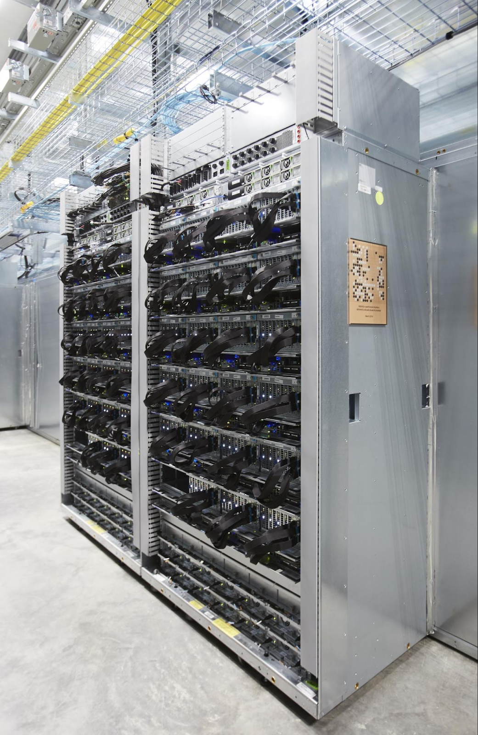
TensorFlow: Solution Strategy
Execution Flexibility via DataFlow abstraction
Makes it easy to extract the parallelism
Provides DFGs for primitive operators
Softmax, convolution, MM, …
Makes it easy to experiment with novel layers
Automatic gradient calculation
Deferred execution
Offload the larger chunks where possible...
Common Abstraction for Accelerators
Easy to integrate new accelerators into the fold
The operators are specialized for different devices
Common data primitive : Tensor
Notes:
1
Both TensorFlow and DistBelief use a dataflow representation for their models, but the most striking difference is that a DistBelief model comprises relatively few complex “layers”, whereas the corresponding TensorFlow model represents individual mathematical operators (such as matrix multiplication, convolution, etc.) as nodes in the dataflow graph. This approach makes it easier for users to compose novel layers using a high-level scripting interface. Many optimization algorithms require each layer to have defined gradients, and building layers out of simple operators makes it easy to differentiate these models automatically (§4.1). In addition to the functional operators, we represent mutable state, and the operations that update it, as nodes in the dataflow graph, thus
2
A typical TensorFlow application has two distinct phases: the first phase defines the program (e.g., a neural network to be trained and the update rules) as a symbolic dataflow graph with placeholders for the input data and variables that represent the state; and the second phase executes an optimized version of the program on the set of available devices. By deferring the execution until the entire program is available, TensorFlow can optimize the execution phase by using global information about the computation. For example, TensorFlow achieves high GPU utilization by using the graph’s dependency structure to issue a sequence of kernels to the GPU without waiting for intermediate results.
3
At a minimum, a device must implement methods for (i) issuing a kernel for execution, (ii) allocating memory for inputs and outputs, and (iii) transferring buffers to and from host memory. Each operator (e.g., matrix multiplication) can have multiple specialized implementations for different devices. As a result, the same program can easily target GPUs, TPUs, or mobile CPUs as required for training, serving, and offline inference.
4.
TensorFlow uses tensors of primitive values as a common interchange format that all devices understand. At the lowest level, all tensors in TensorFlow are dense; sparse tensors can be represented in terms of dense ones (§3.1). This decision ensures that the lowest levels of the system have simple implementations for memory allocation and serialization, thus reducing the framework overhead. Tensors also enable other optimizations for memory management and communication, such as RDMA and direct GPU-to-GPU transfer.
The main consequence of these principles is that in TensorFlow there is no such thing as a parameter server. On a cluster, we deploy TensorFlow as a set of tasks (named processes that can communicate over a network) that each export the same graph execution API and contain one or more devices. Typically a subset of those tasks assumes the role that a parameter server plays in other systems [11, 14, 20, 49], and we therefore call them PS tasks; the others are worker tasks. However, since a PS task is capable of running arbitrary TensorFlow graphs, it is more flexible than a conventional parameter server: users can program it with the same scripting interface that they use to define models. This flexibility is the key difference between TensorFlow and contemporary systems, and in the rest of the paper we will discuss some of the applications that this flexibility enables.

Slide 66
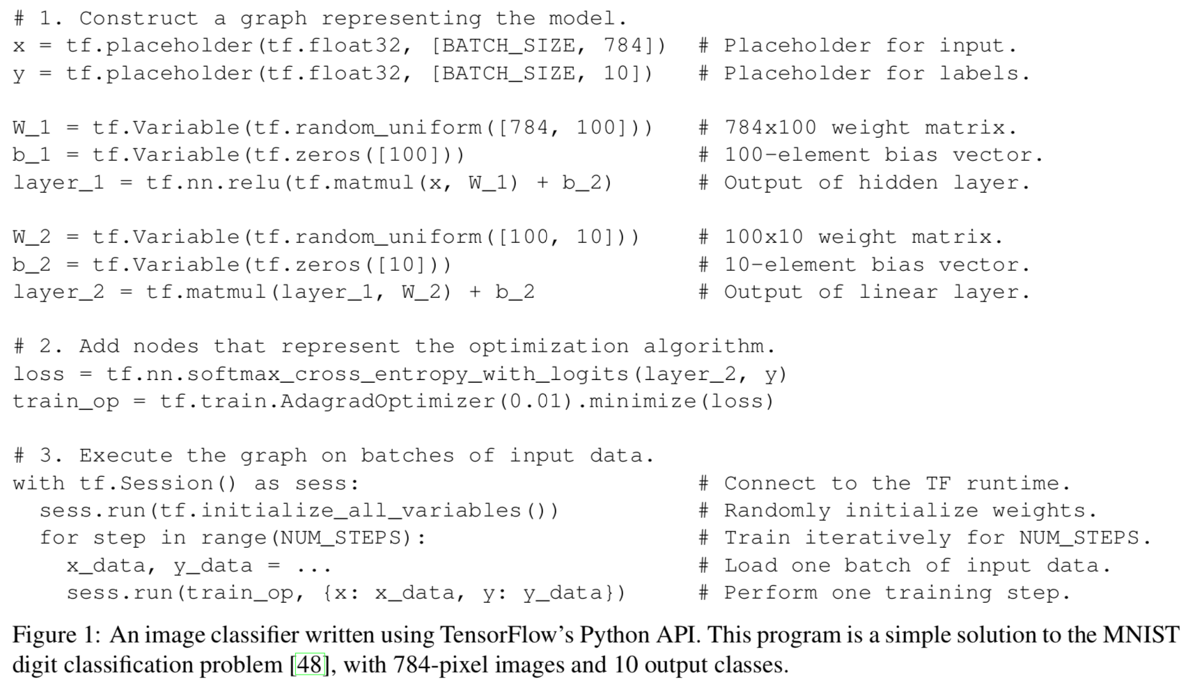
TensorFlow API Example

Slide 67
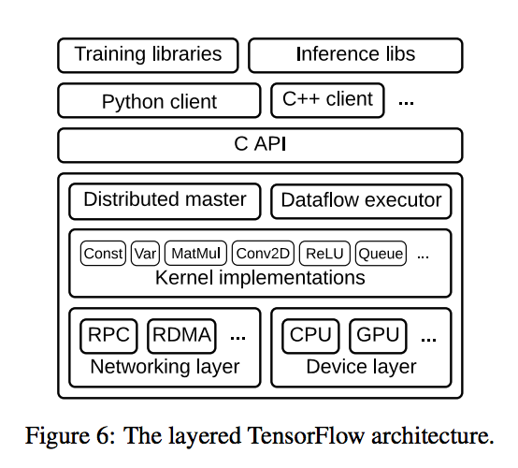
TensorFlow Implementation

Slide 68
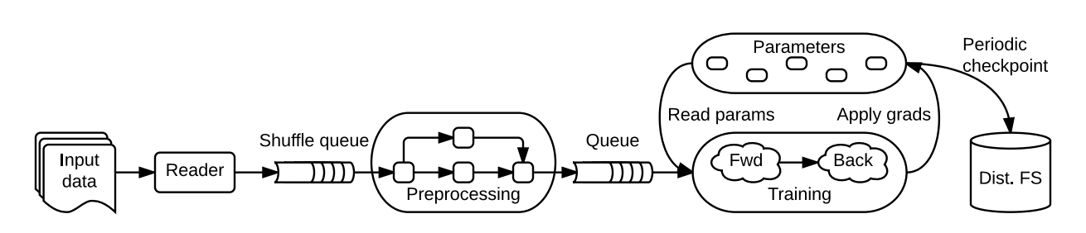
Execution Model
Single DFG represents all computation and state for ML algorithm
Input preprocessing, mathematical operators, parameters, parameter update rules
Communication explicit, simplifying scheduling and partitioning

Slide 69
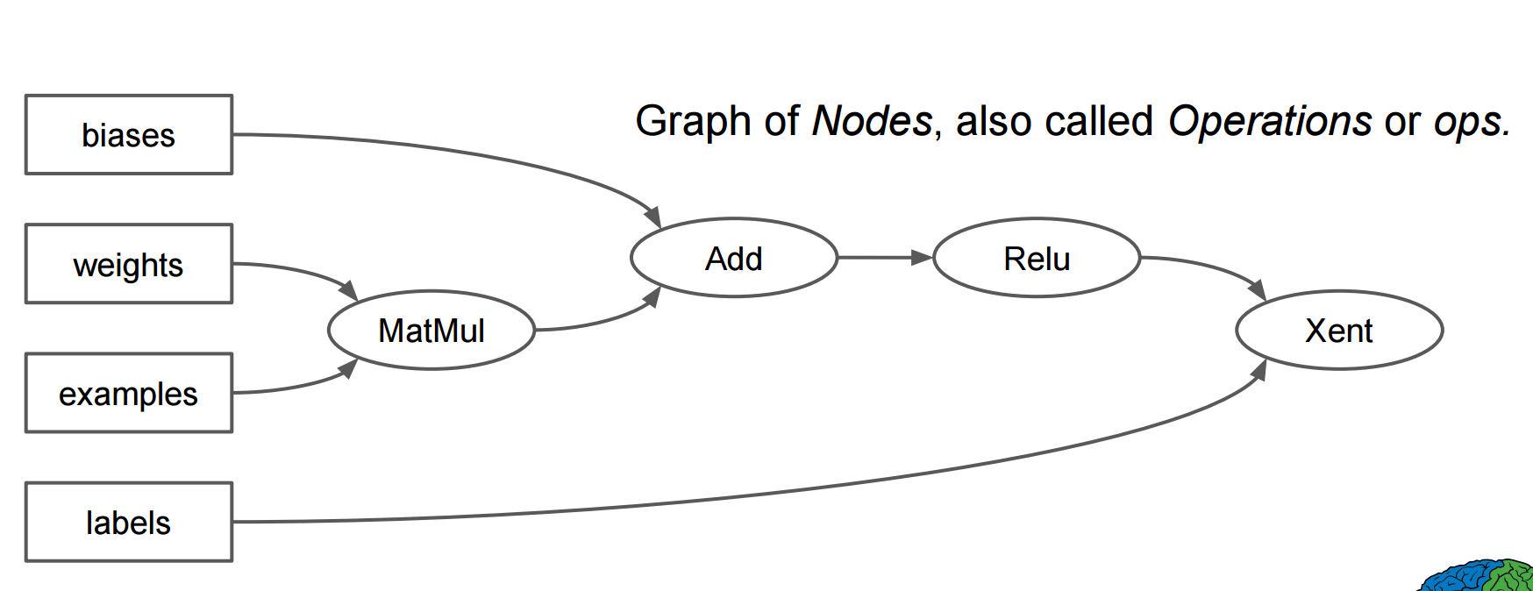
Computation is a DFG

Slide 70
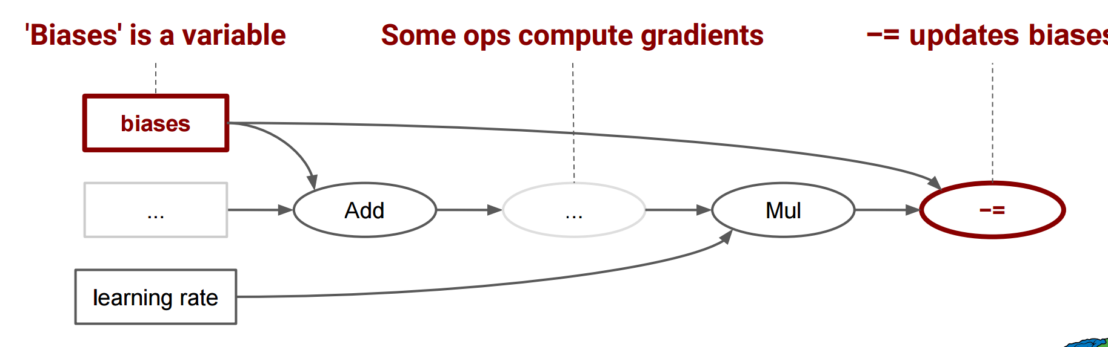
Execution Model
Single DFG represents all computation and state for ML algorithm
Input preprocessing, mathematical operators, parameters, parameter update rules
Communication explicit, simplifying scheduling and partitioning
Differences with existing DF systems:
Concurrent execution on overlapping subgraphs supported
Individual vertices contain sharable, mutable state

Slide 71
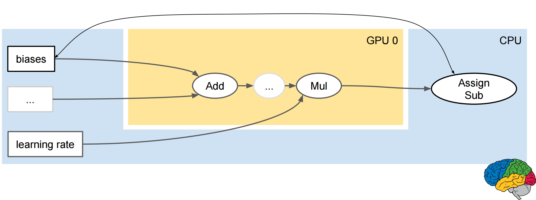
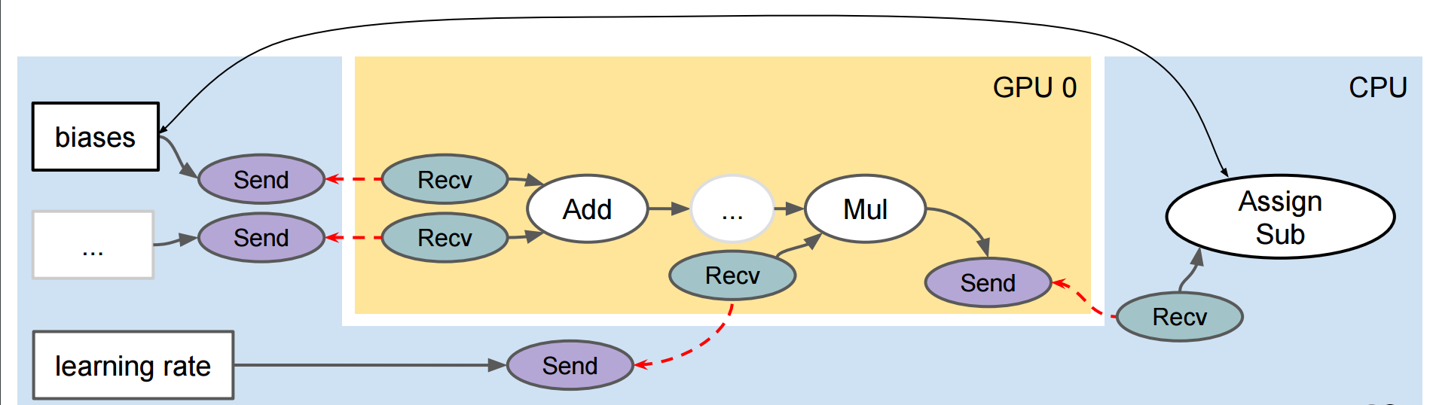
Communication is explicit...
TensorFlow handles the glue

Slide 72
Fault Tolerance
Days or many hours to train models -- fault tolerance is key
Don’t need perfect recovery mechanisms
Strong consistency is not needed for ML
User-level checkpointing operations and client library for configuration
SAVE/RESTORE

Slide 73
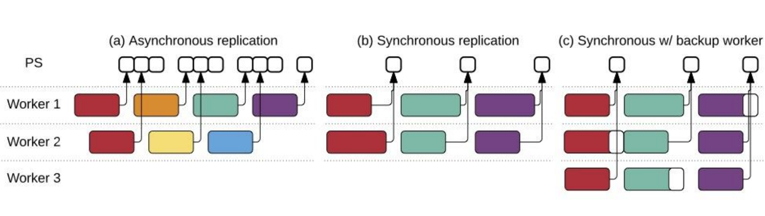
Time-to-Quality vs Time-per-Update
Synchronous updates can be delayed by stragglers
SGD found to be robust to asynchrony
Asynchronous = better utilization...
But with GPGPUs fewer machines needed, less coordination overhead
Asynchronous operation can suffer from stale updates
TensorFlow can handle Asynch or Synch updates...
Also, synchronous + backup workers
Idea: have K backup workers and N workers, then simply take updates from first N workers that complete

Slide 74
How to evaluate this?

Slide 75
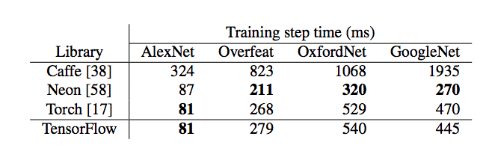
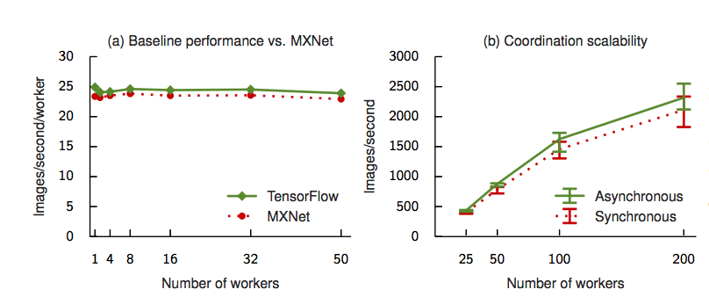

Slide 76


Slide 77
TVM: An automated end-to-end optimizing compiler for Deep learning
Tianqi Chen and Thierry Moreau, University of Washington; Ziheng Jiang, University of Washington, AWS; Lianmin Zheng, Shanghai Jiao Tong University; Eddie Yan, Haichen Shen, and Meghan Cowan, University of Washington; Leyuan Wang, UC Davis, AWS; Yuwei Hu, Cornell; Luis Ceze, Carlos Guestrin, and Arvind Krishnamurthy, University of Washington
OSDI’18

Slide 78
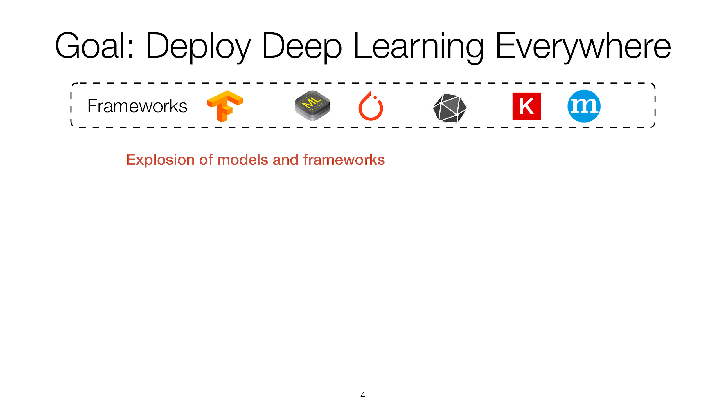

Slide 79
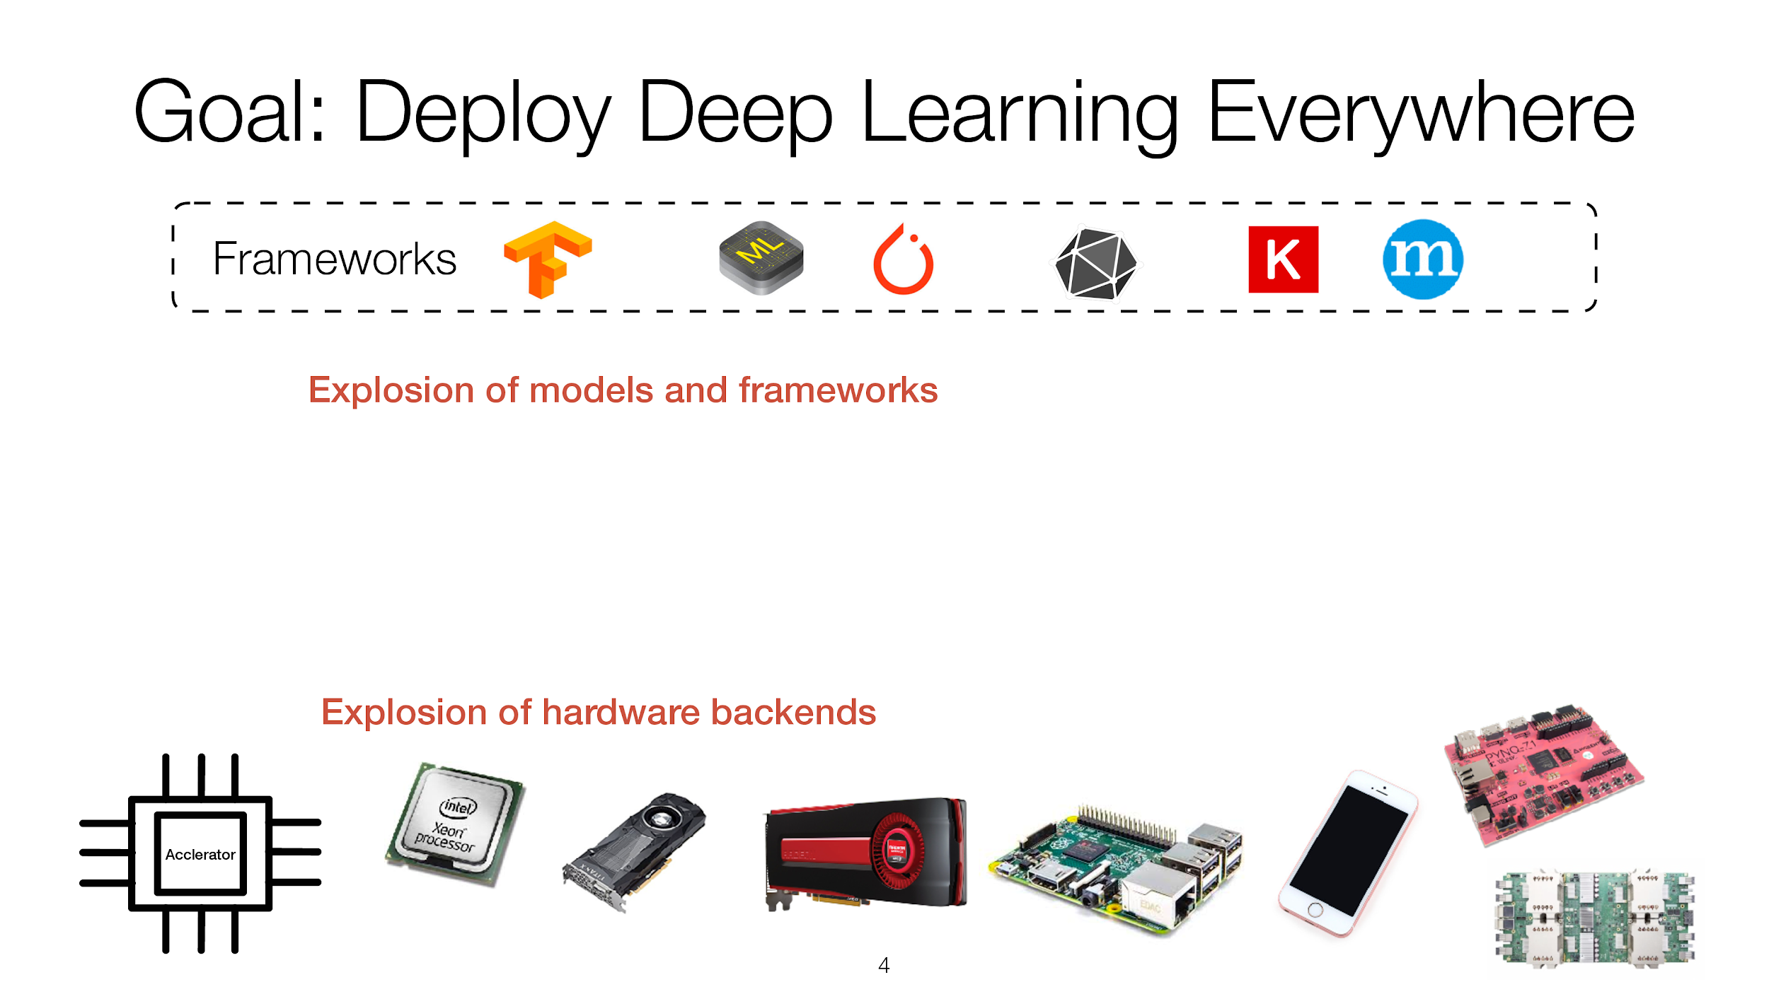

Slide 80
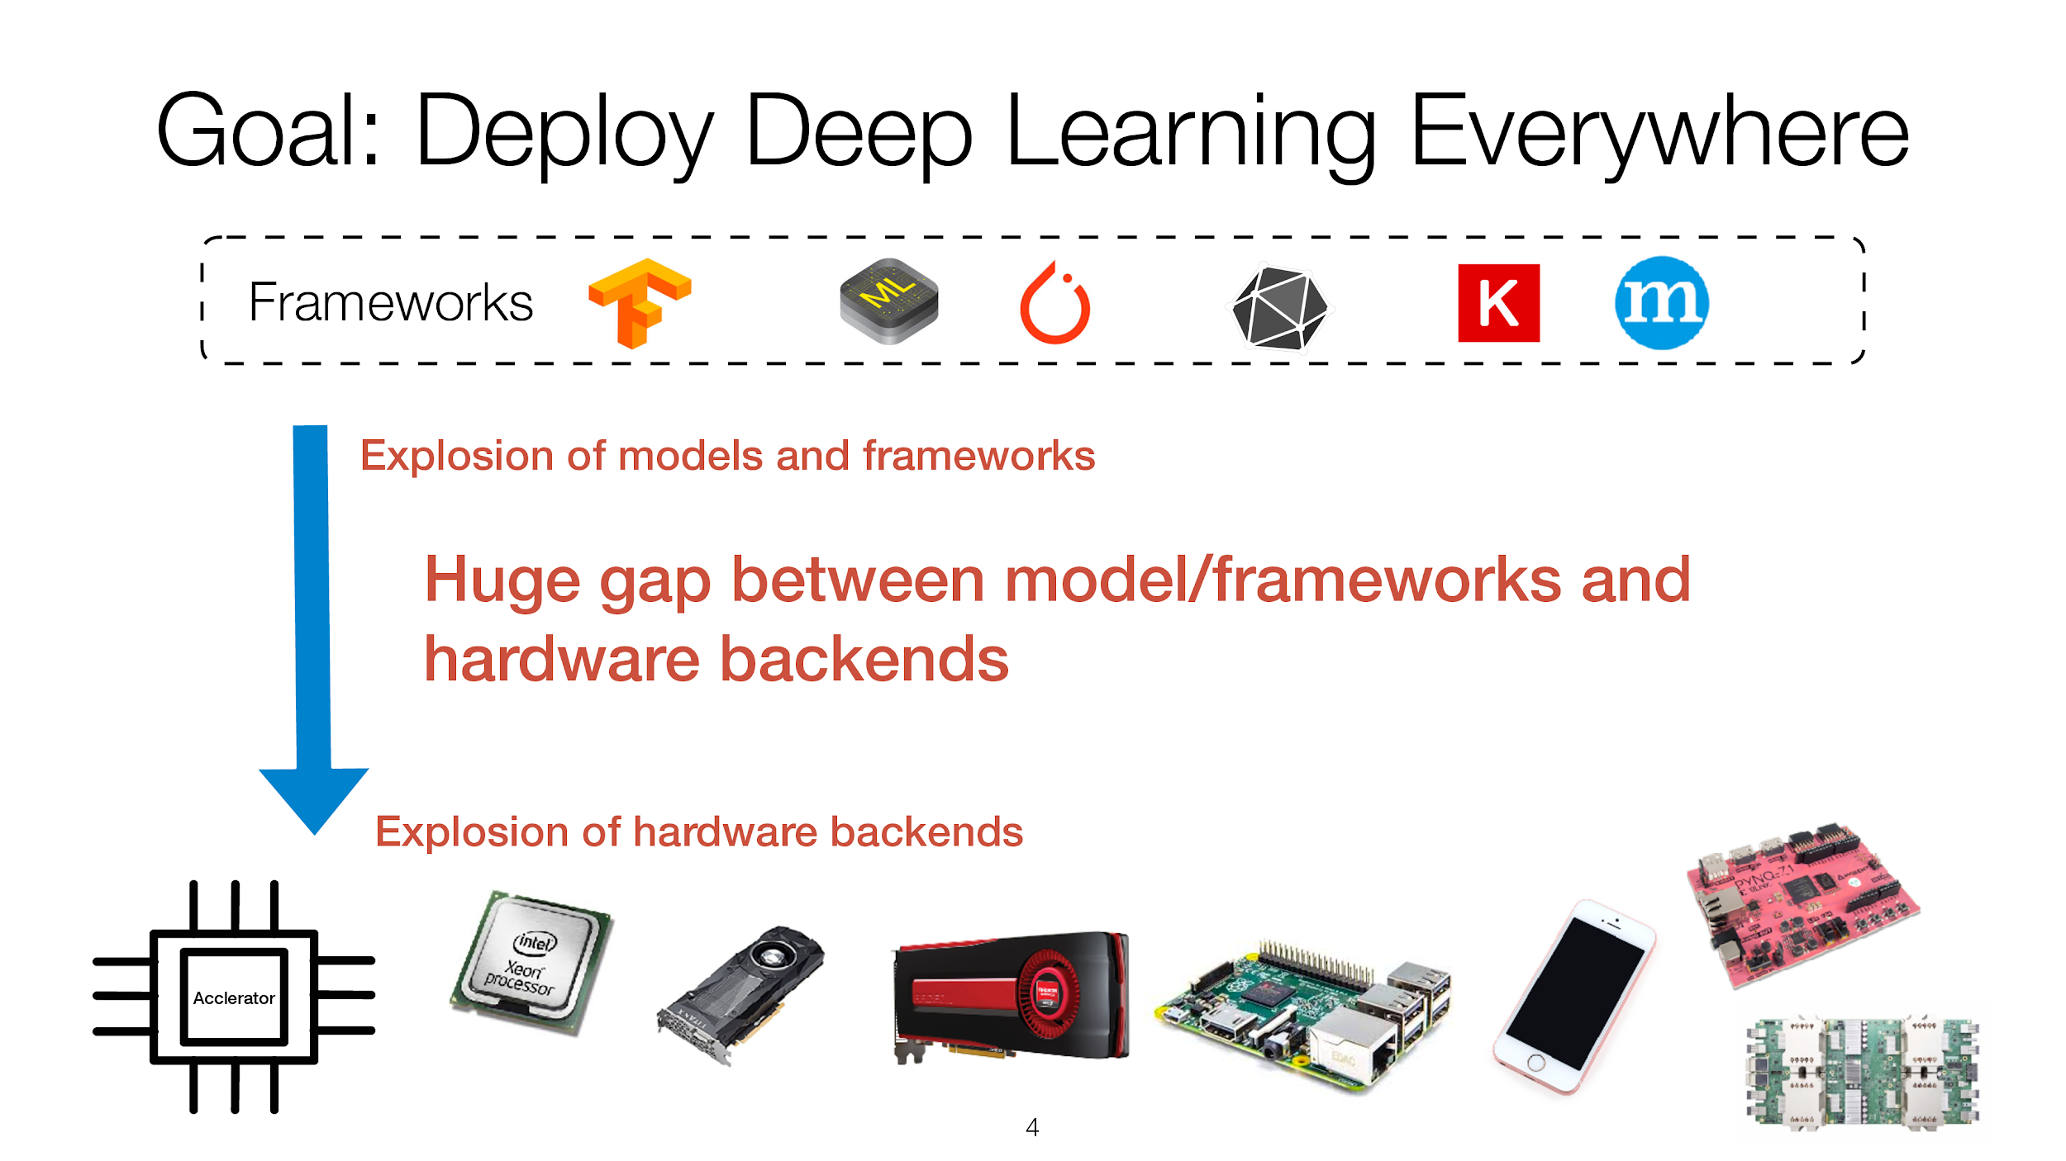

Slide 81
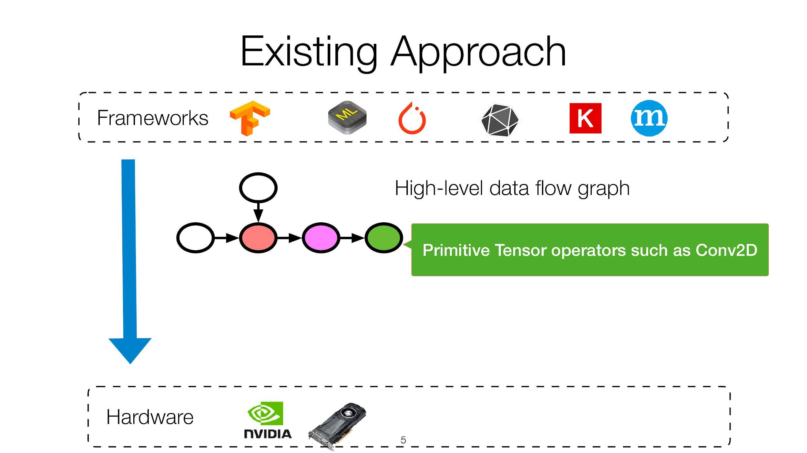

Slide 82
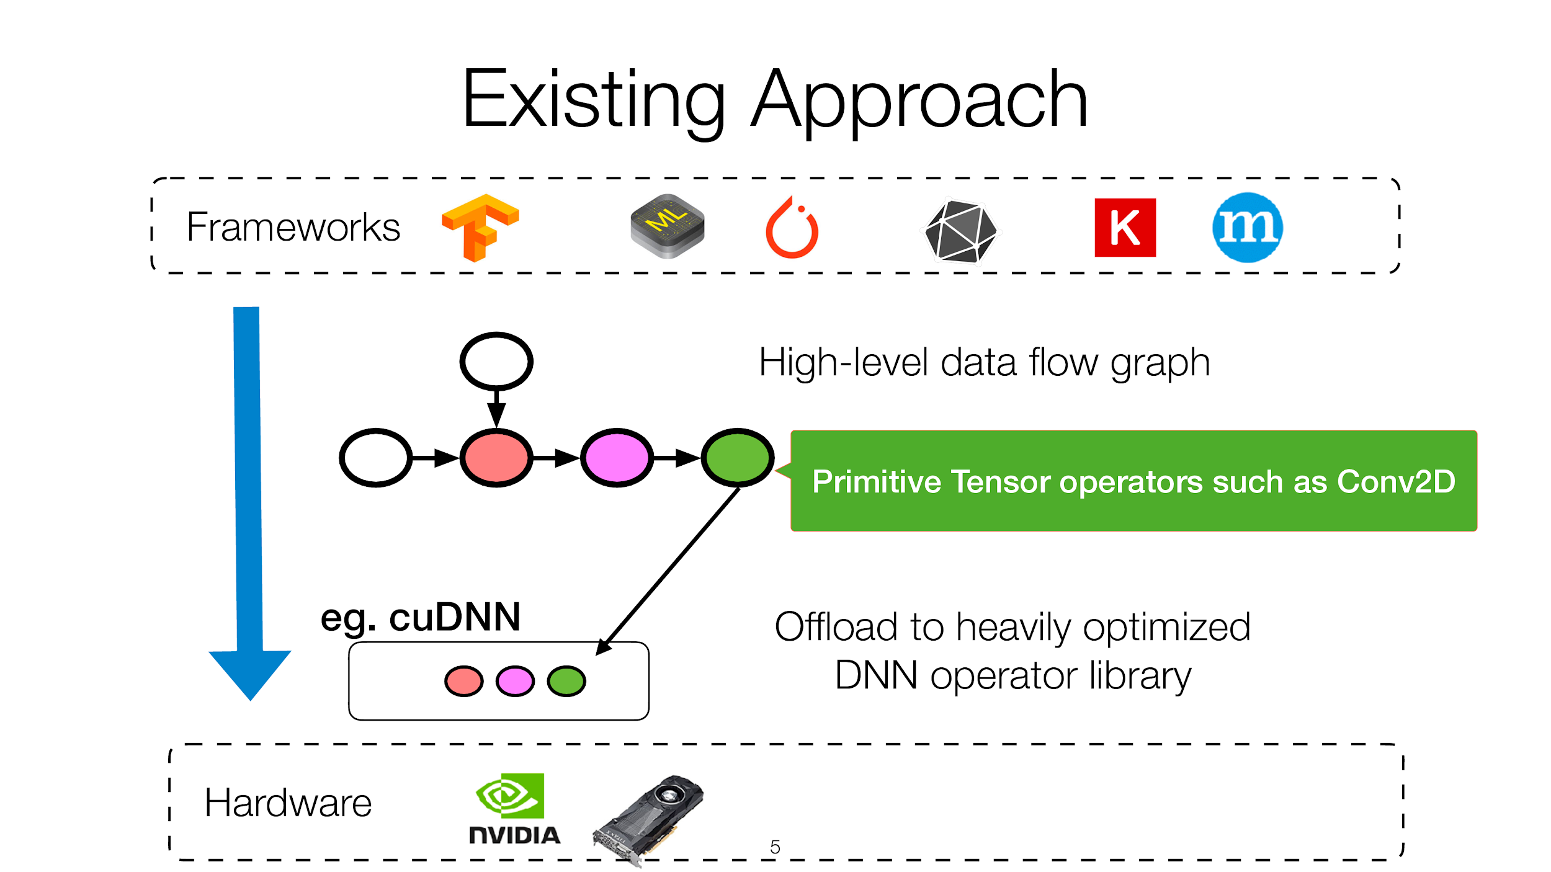

Slide 83
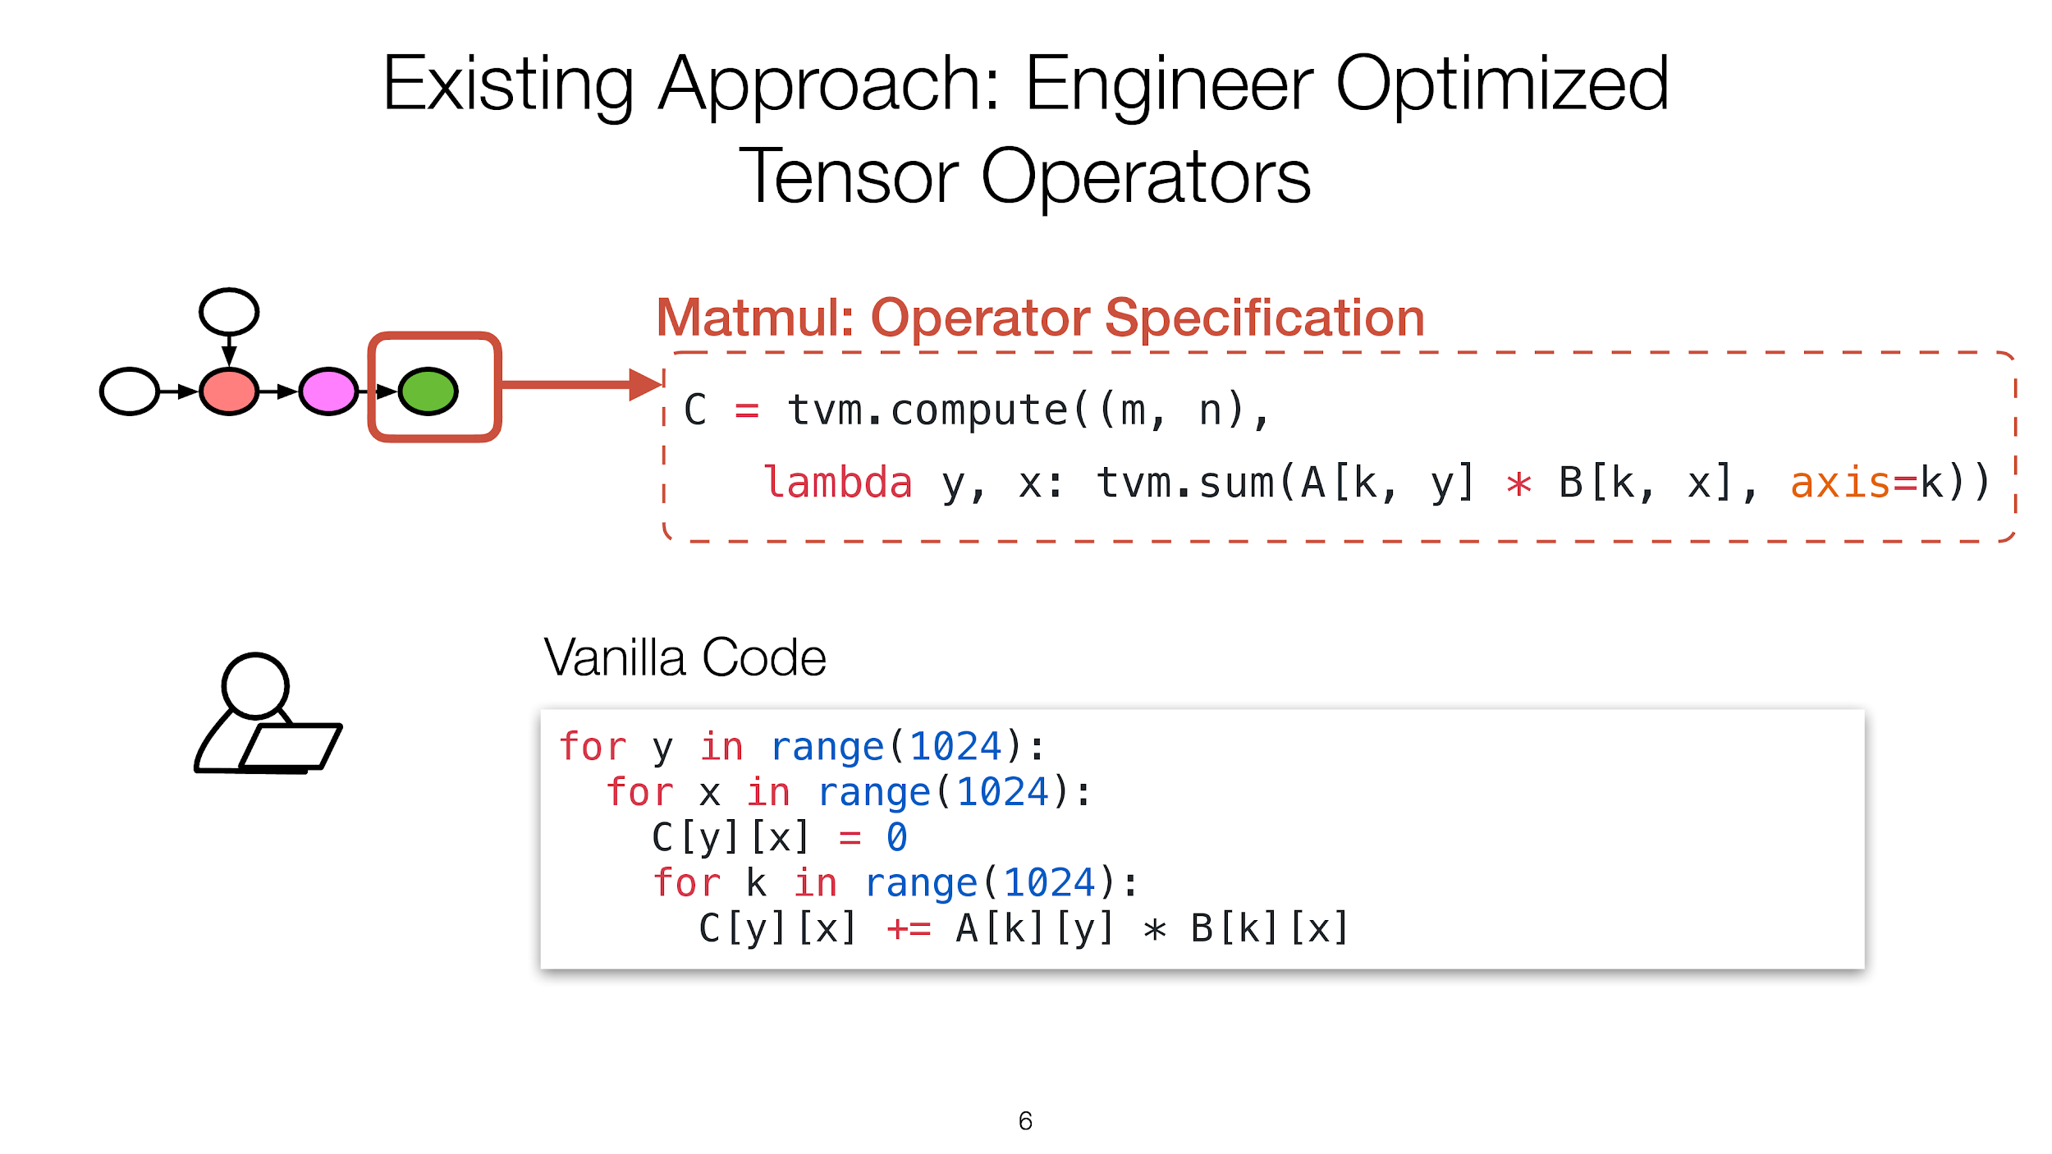

Slide 84
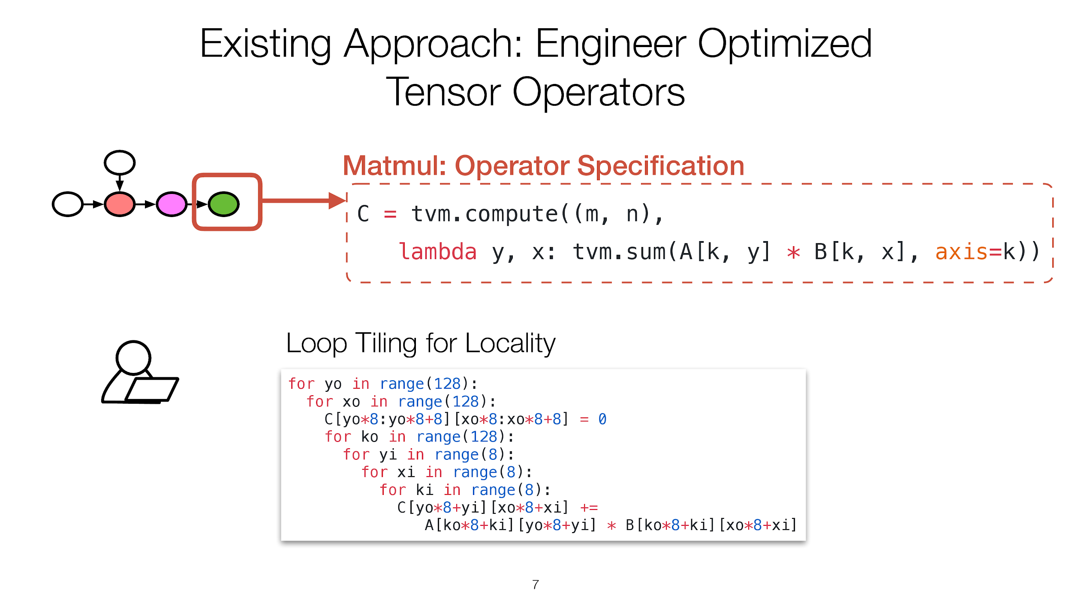

Slide 85
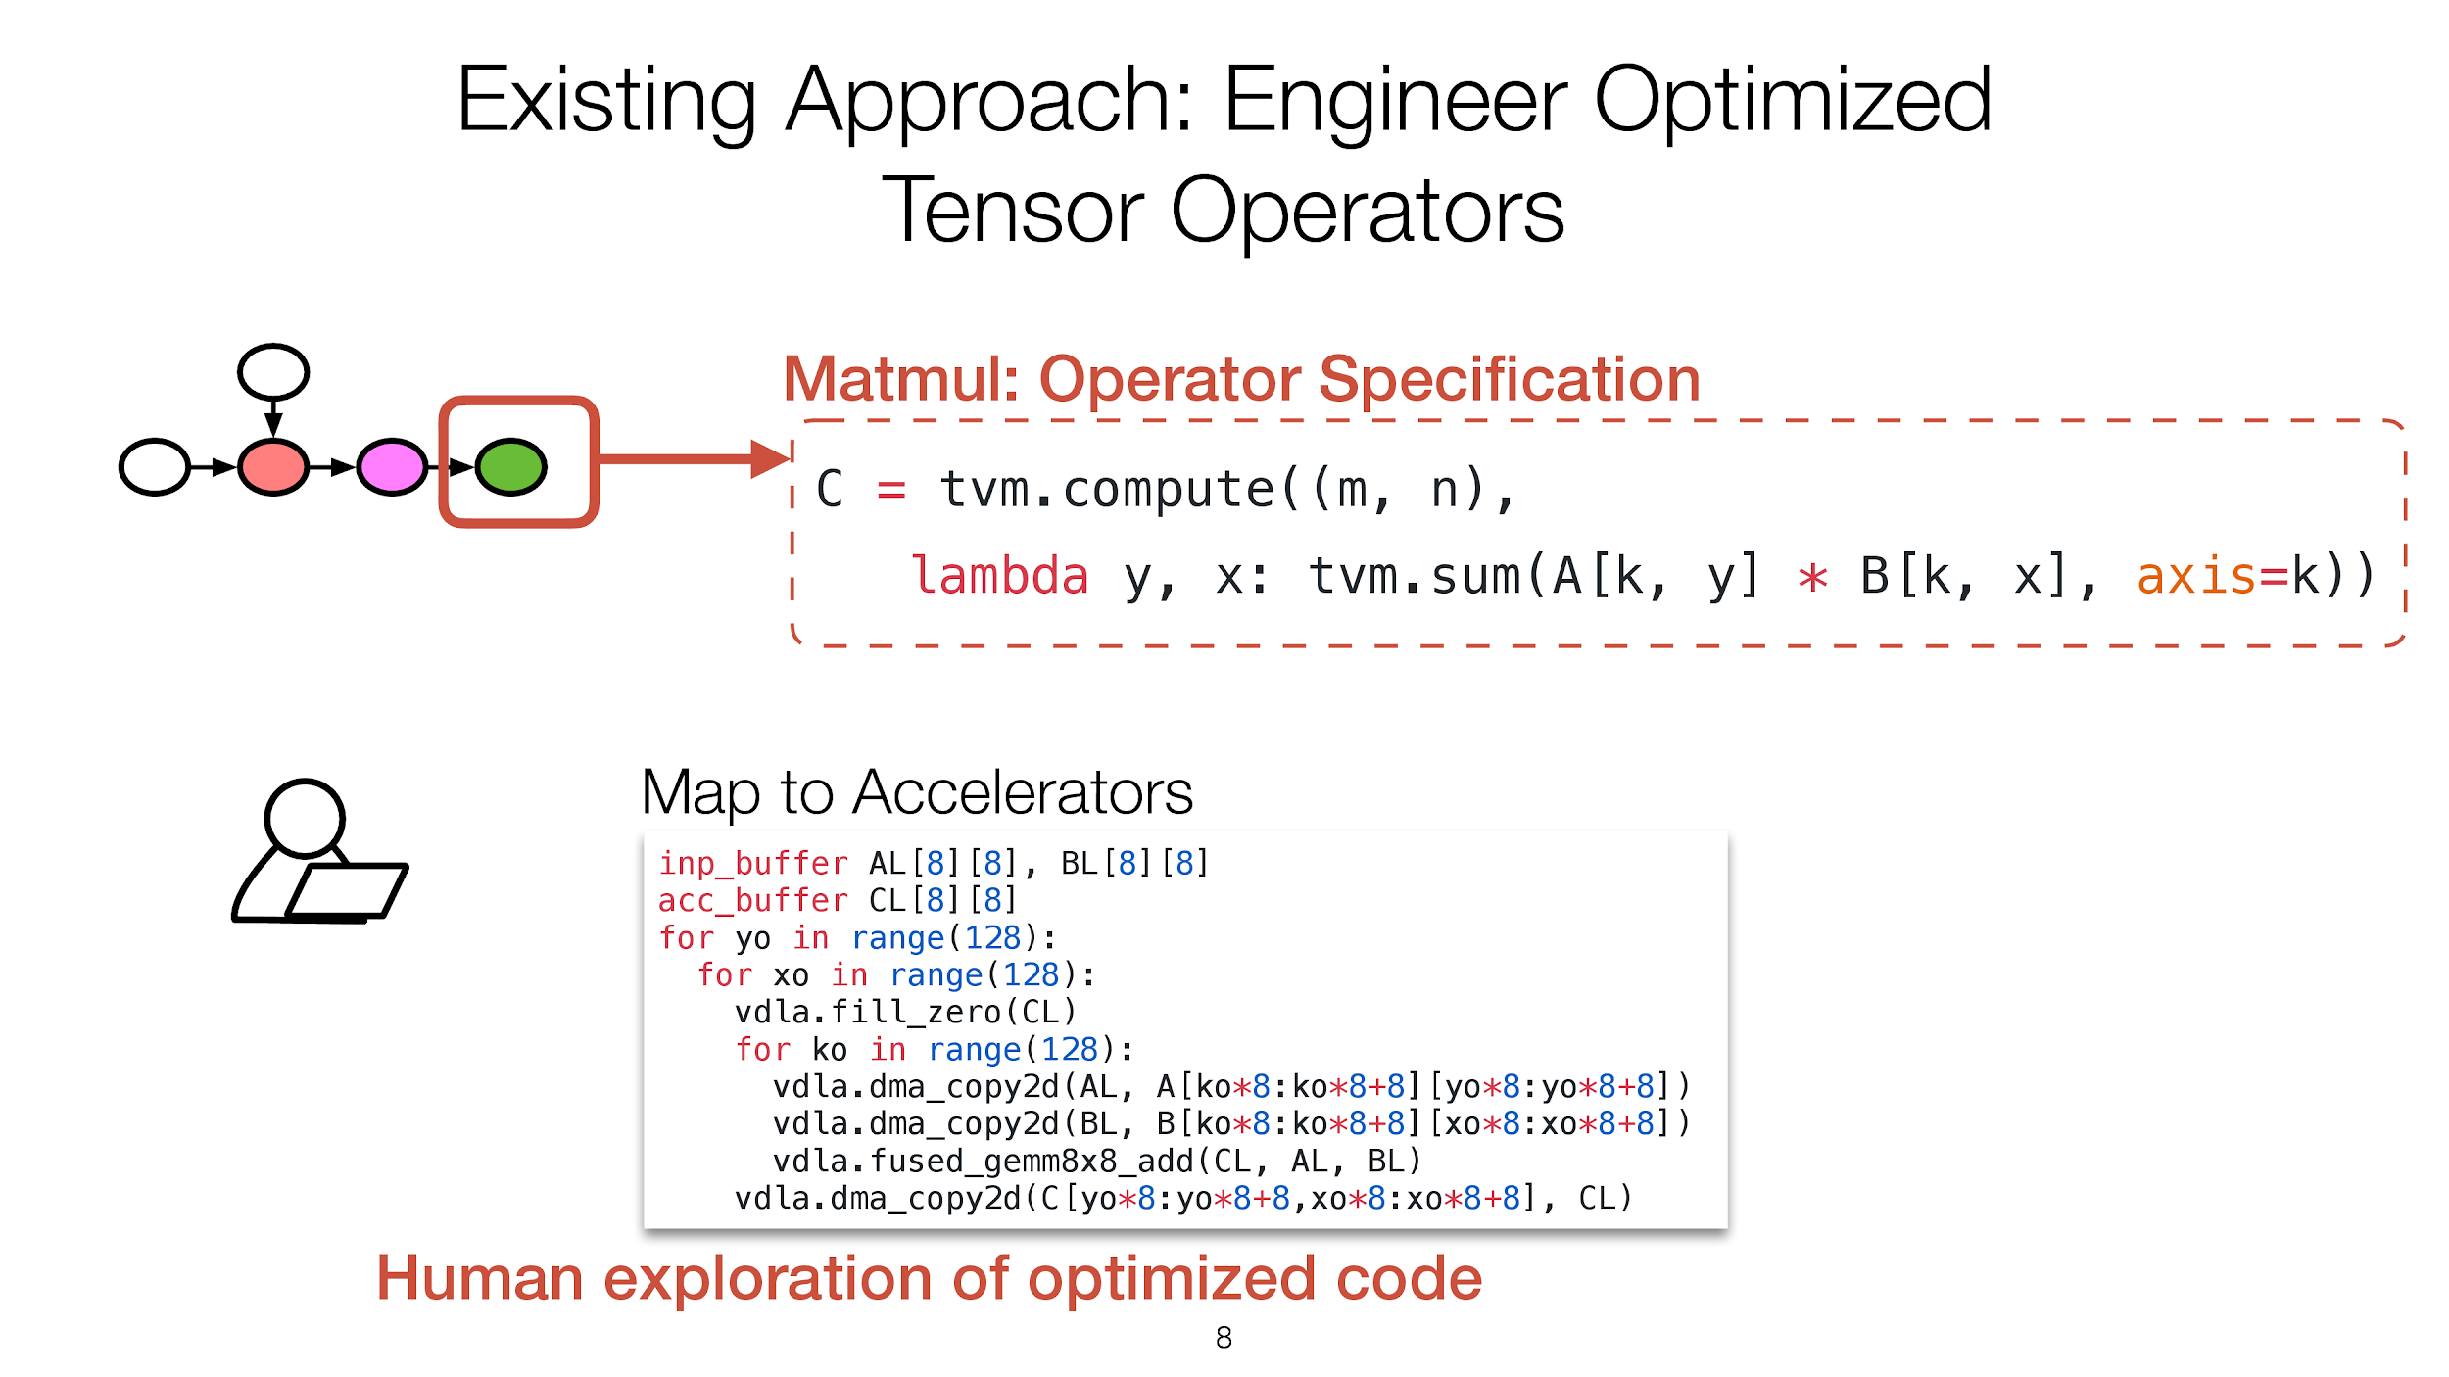

Slide 86
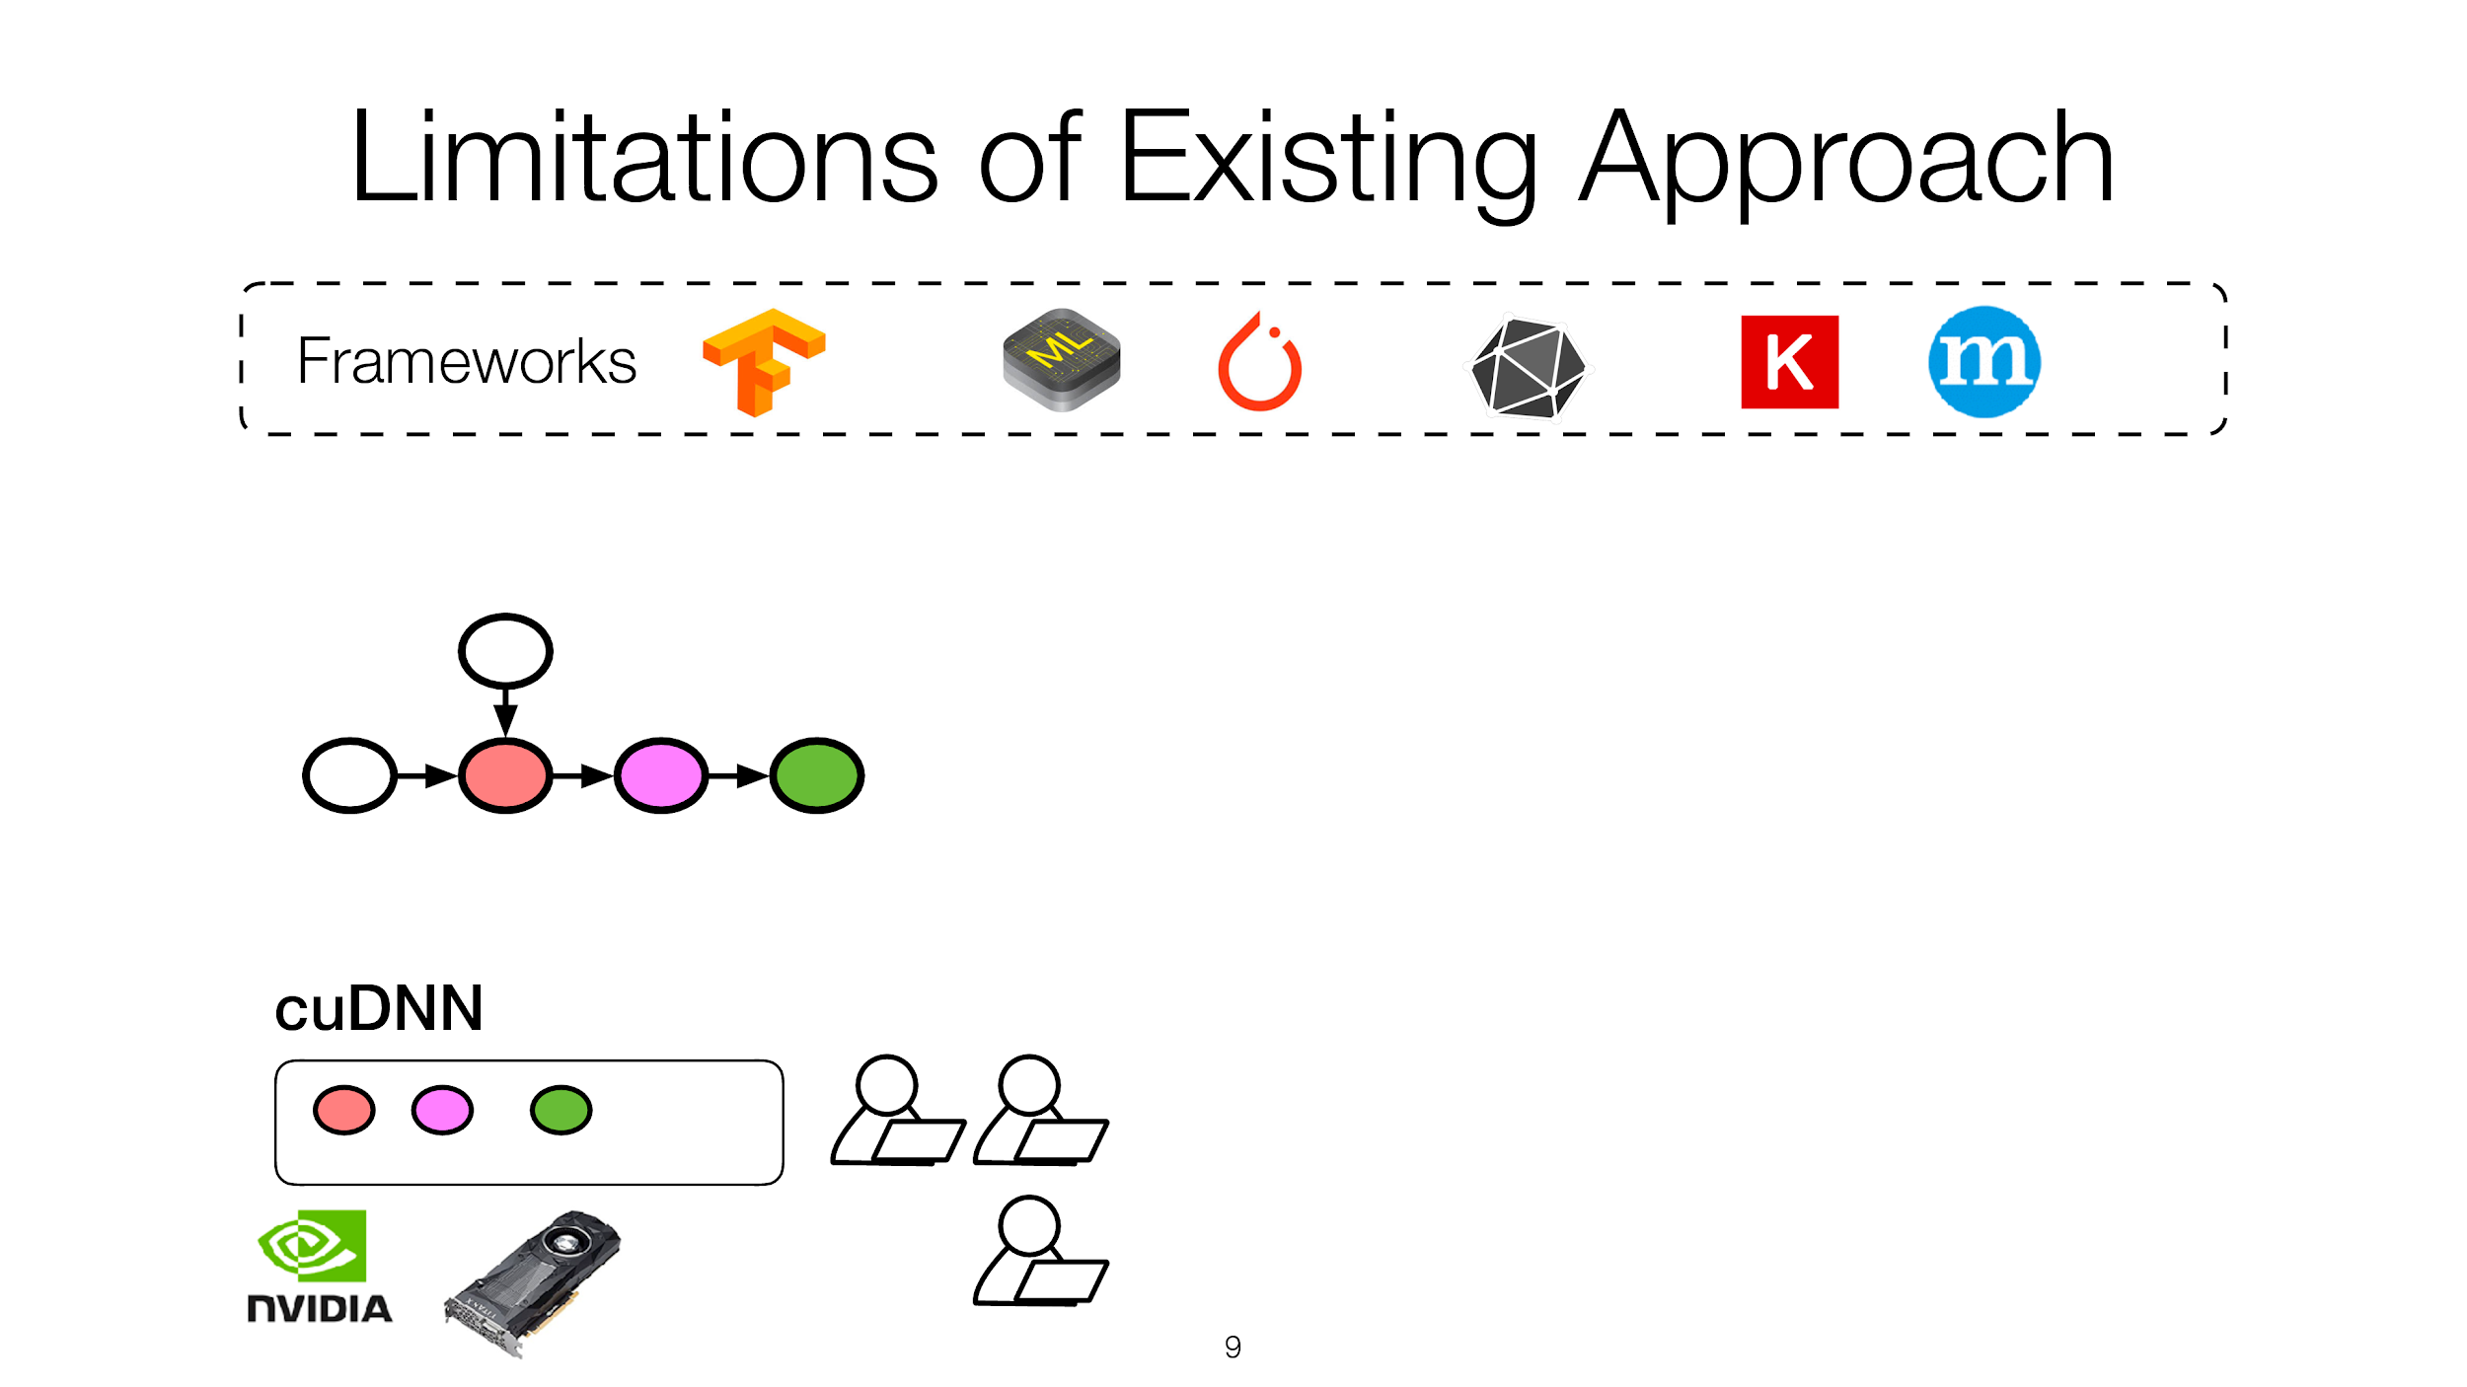

Slide 87
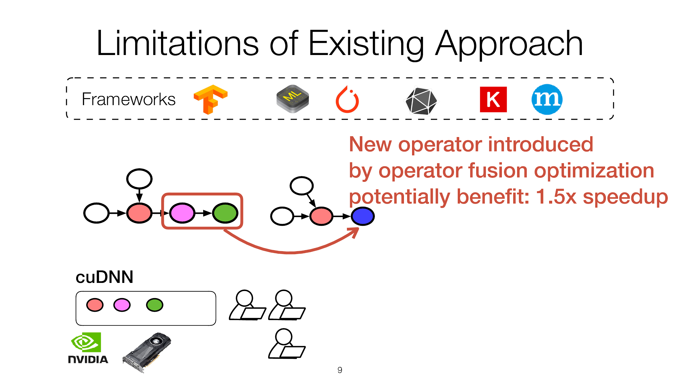

Slide 88
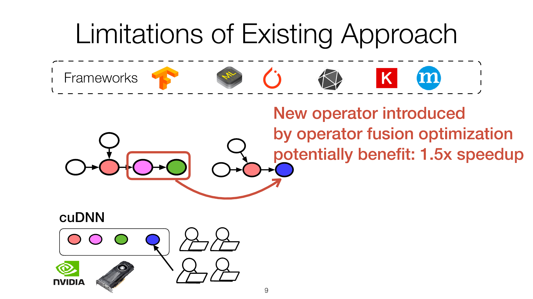

Slide 89
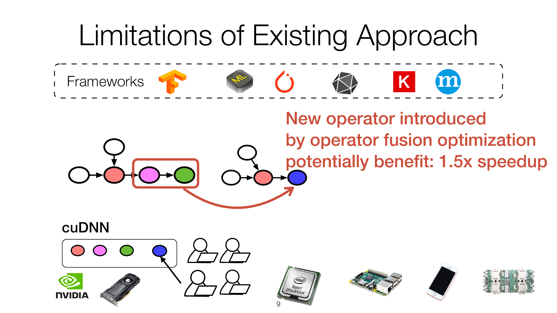

Slide 90
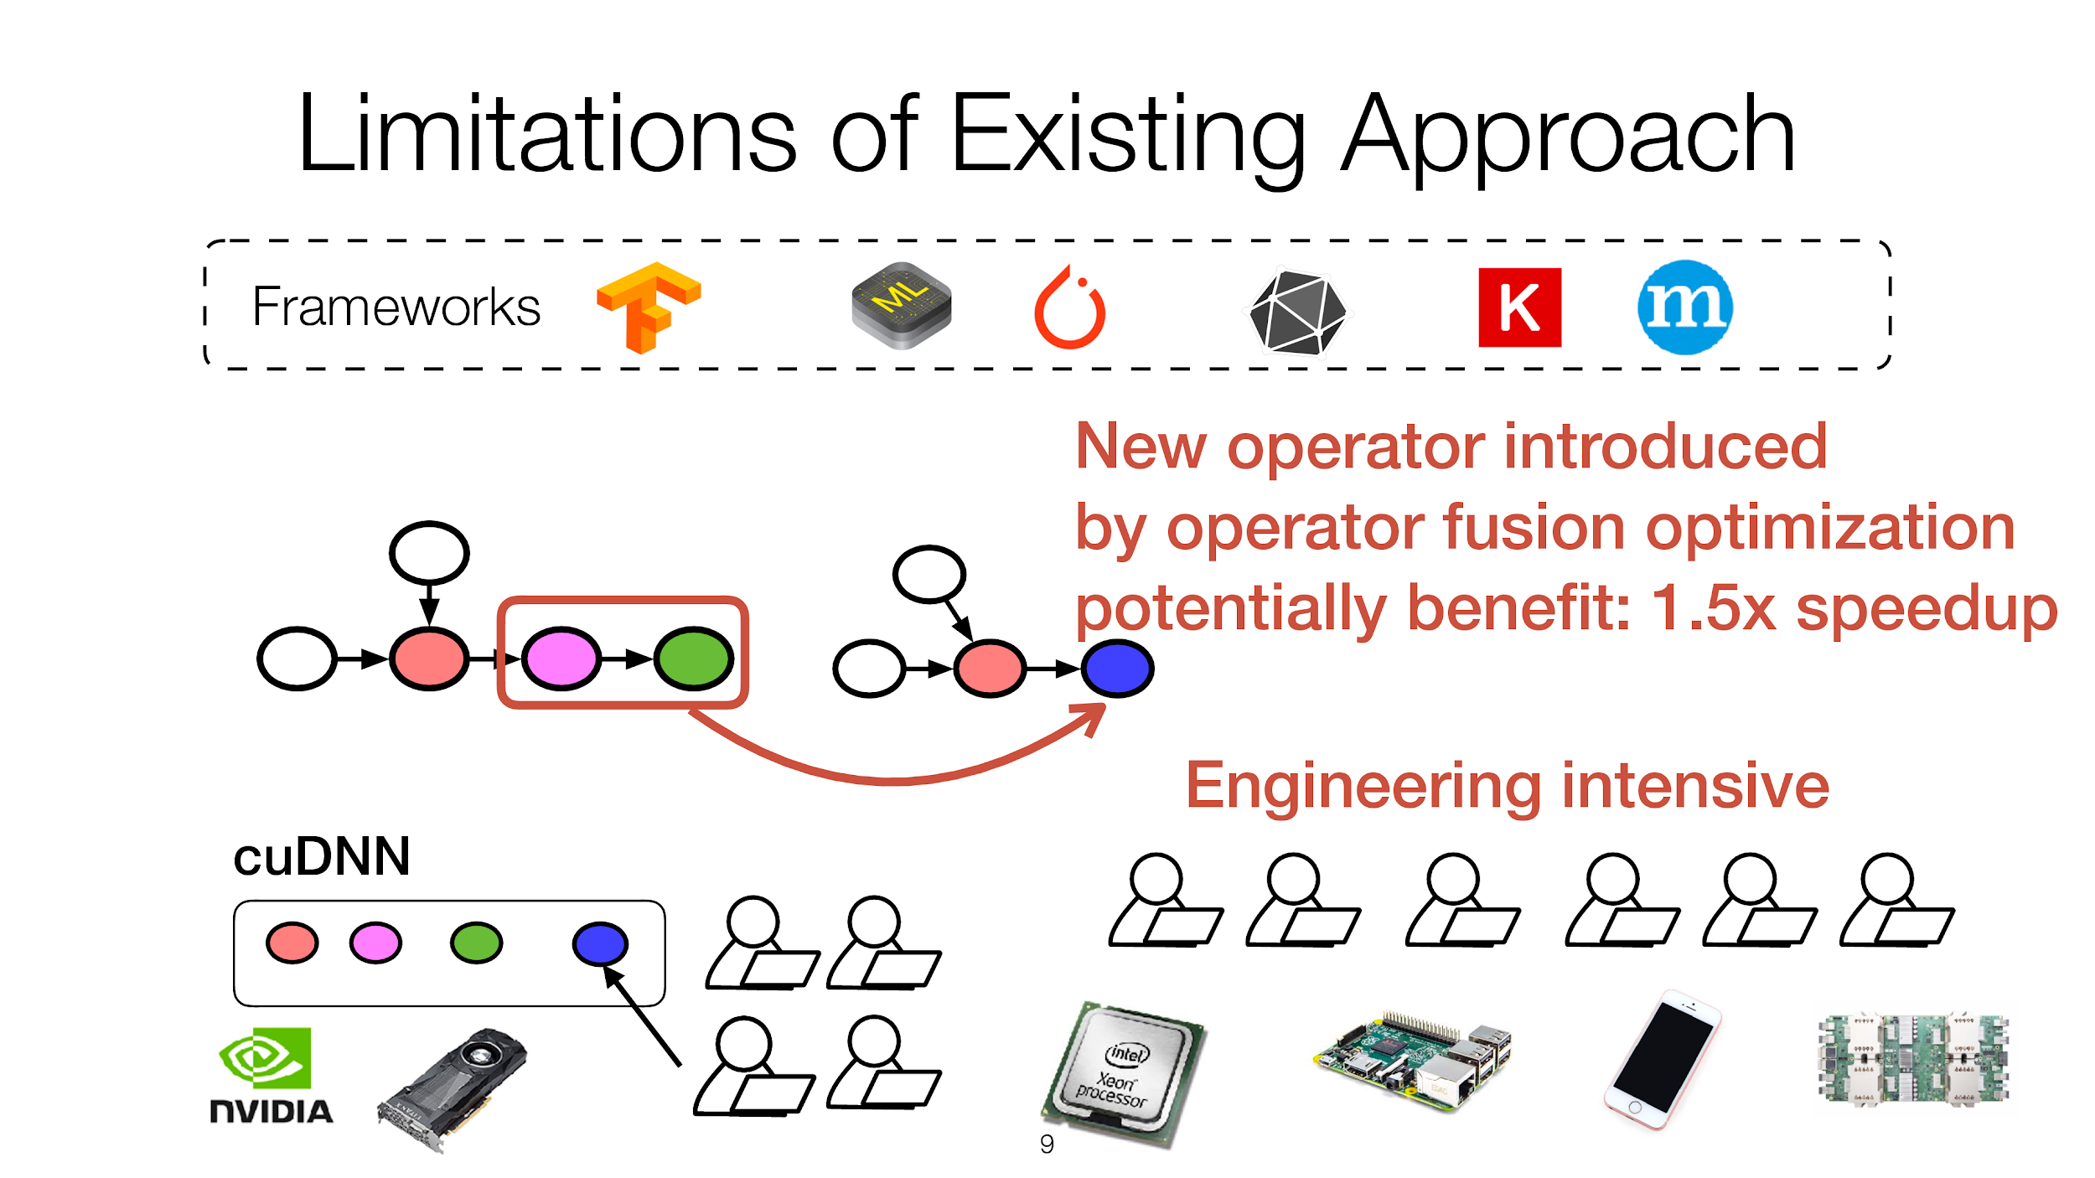

Slide 91
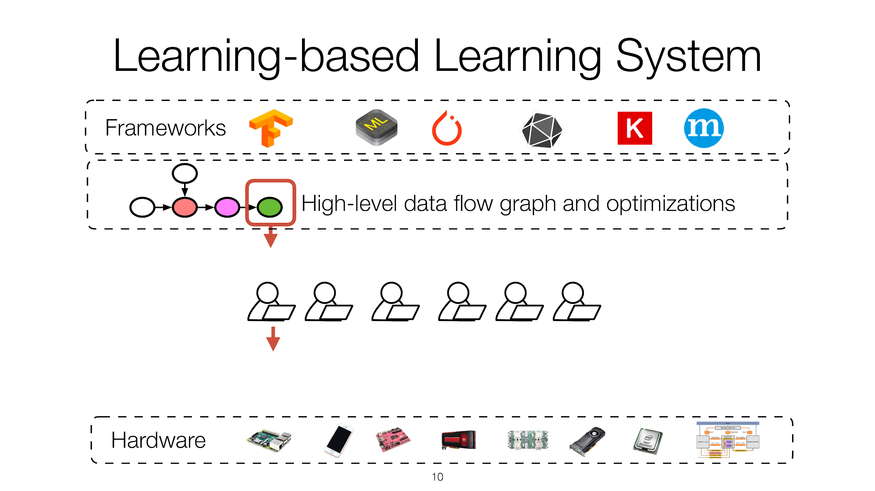

Slide 92
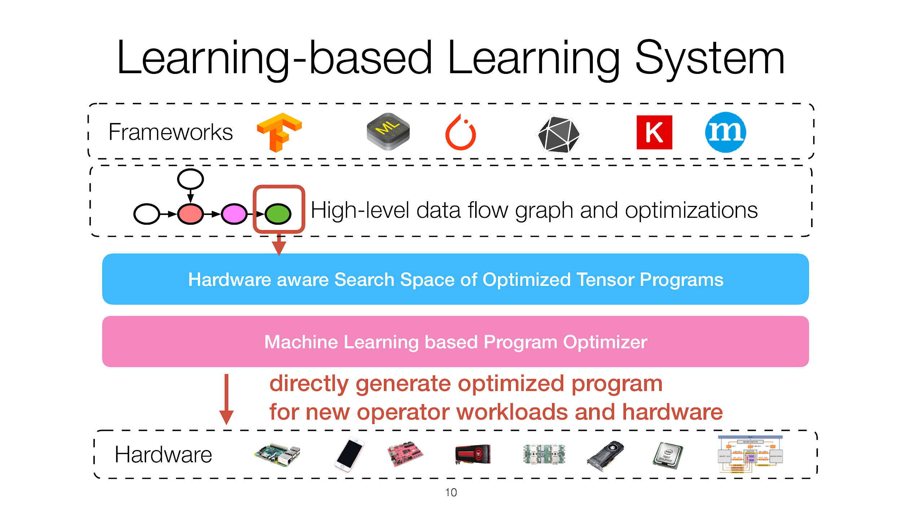

Slide 93


Slide 94


Slide 95


Slide 96


Slide 97


Slide 98


Slide 99


Slide 100


Slide 101


Slide 102


Slide 103


Slide 104


Slide 105
DeepXplore: Automated Whitebox Testing of Deep Learning Systems
Kexin Pei¹, Yinzhi Cao², Junfeng Yang¹, Suman Jana¹
¹Columbia University, ²Lehigh University
SOSP’17

Slide 106



Deep learning (DL) has matched human performance!
Image recognition, speech recognition, machine translation, intrusion detection...
Wide deployment in real-world systems

Slide 107



Deep learning is increasingly used in safety-critical systems
Deep learning correctness and security is crucial
Self-driving car
Medical diagnosis
Malware detection

Slide 108

Unreliable deep learning contributed to Tesla fatal crash
Tesla autopilot failed to recognize a white truck against bright sky leading to fatal crash

Slide 109
Existing DL testing methods are seriously limited
Common practice: measure accuracy on a test input set of randomly chosen data
Problem 1: how good is the coverage of the test set?
DL decision logic is incredibly complex
More fundamentally, what is testing coverage metric for DL?
Problem 2: it requires expensive labeling effort
Data in test set must be manually labelled
To enlarge the test set, we need to manually label more data

Slide 110

Existing DL testing methods are seriously limited (cont.)
Adversarial testing (Szegedy et al. ICLR’14): find corner-case inputs imperceptible to human but induce errors
Problem 1: how good is the coverage of the test set?
Problem 2: it requires expensive labeling effort
Problem 3: Not realistic. (Theoretical, assumes a very powerful adversary. [Sharif et al. CCS’16])
School bus
Carefully crafted noise
Ostrich

Slide 111

Many traditional software testing techniques don’t apply to deep learning
Deep learning decision logic is embedded in neurons and layers, not in code
x=0
If (x==8)
x+=1
x+=2
Neural network
Traditional program
(control flow graph)

Slide 112



Quick Summary of DeepXplore
The first step towards systematic testing of Deep Neural Nets (DNNs)
Neuron coverage: first testing coverage metric for deep nerual net
Automated: cross-check multiple DNNs
Realistic: physically realizable transformations
Effective:
15 State-of-the-art DNNs on 5 large datasets (ImageNet, Self-driving cars, PDF/Android malware)
Numerous corner-case errors
50% more neuron coverage than existing testing
No accident
DeepXplore
Darker: Accident

Slide 113




How DeepXplore works?
Feed into multiple DNNs
DNN1
Seed inputs without labels
Testing as an optimization problem
Right
23^{O}
25^{O}
20^{O}
DNN2
Objectives:
Maximize differences & neuron coverage
under realistic constraints
(e.g., lighting)
Right
22^{O}
24^{O}
20^{O}
DNN3
Right
Left
Mutate using gradient descent (DNNs are differentiable)
12^{O}
21^{O}
10^{O}
On new input, activate different neurons

Slide 114
How to achieve multiple goals simultaneously
Goal 1: systematically find corner cases
Generate inputs that maximize neuron coverage
Goal 2: find DNN errors without manual labels
Differential testing: use multiple DNNs as cross-referencing oracles
Goal 3: generate realistic test inputs
Domain-specific constraints
DNNs are differentiable → use gradient descent to solve the optimization problem
Apply mutation w.r.t input with realistic constraints
See paper for details
Objectives:
Maximize corner-case differences & neuron coverage
under realistic constraints
(e.g., lighting)
Testing DNNs is an optimization problem

Slide 115

Neuron coverage → how much decision logic exercised
Neuron coverage = # neurons activated / # total neurons
Intuition: layerwise feature detection (Lee et al. ICML’09)
Nose
f: ReLU max(x,0)
3
hedge
...
Car
2
f(1)
...
Eyes
...
1
-11
1
1
vedge
...
Face
3
Activation threshold=0.75
2
Wheel
[3,1,2] [2,-11,1]^{T}=1
Neuron coverage: 4/7=57%
.

Slide 116
Implementation
DeepXplore
Keras 2.0.3
Efficient gradient computation &
support for intercepting outputs of intermediate neurons for calculating neuron coverage
TensorFlow 1.0.1
CPU
GPU
Linux

Slide 117
Evaluation setup and results summary
Dataset | Description | DNNs | Original random testing accuracy | Avg. neuron coverage improvement over random/adversarial | Avg. Violations found by DeepXplore (2000 seeds)
MNIST | Handwritten digits | LeNet variants | 98.63% | 30.5% → 70% | 1,289
ImageNet | General Images in 1000 categories | VGG16, VGG19, ResNet15 | 93.91% | 1% → 69% | 1,980
Driving | Udacity self-driving car competition dataset | Nvidia Dave-2 variants | 99.94% | 3.2% → 59% | 1,839
Contagio/VirusTotal | PDF malware | Fully connected | 96.29% | 18% → 70% | 1,048
Drebin | Android malware | Fully connected | 96.03% | 18.5% → 40% | 2,000

Slide 118








Sample corner-case errors for images
Driving:
Driving:
Go straight
Turn right
Go straight
Turn left
ImageNet:
ImageNet:
Light cardigan
Diaper
bolete
buckeye
MNIST:
MNIST:
6
2
5
3

Slide 119
Limitations of Approach
Common to all differential testing solutions
We must have at least two DNNs with the same functionality
Can only detect an erroneous behavior if at least one DNN produces different results that the other DNNs

Slide 120
The Case for Learned Index Structures
Tim Kraska, Alex Beutel, Ed H. Chi, Jeffrey Dean, and Neoklis Polyzotis. 2018. The Case for Learned Index Structures. InSIGMOD’18: 2018International Conference on Management of Data.

Slide 121

Problem: Static data structures assume certain context about data
“One Size Does Not Fit All”
Traditional data structures do not account for the nature of data
Scales poorly with more data
Do not take advantage of common patterns in real world data
Suboptimal edge cases can fail with increases in computation time by orders of magnitude.
Learn the data distribution for time, space, performance improvements
Scale with complexity, not size
Machine Learning, Reinforcement Learning, and Neural Nets can replace, complement, improve existing heuristics and system operations.
Notes:
1.
A. Linear Trend , O(n)
B. Example from before
C. Join Query Optimization

Slide 122

B-Trees: Data structure to locate a record
CPU Cache
Main Memory
Disk / Main Memory
Notes:
3 Case Studies
B-Trees
Hashmaps
Bloom Filters
Models are largely supervised, prediction problems

Slide 123

Lookup data structures already use models
Hypothesis: can replace them with learned models
Smaller Index
Faster Lookup
More Parallelism
Cheaper Insertion
Hardware Acceleration
Notes:
B-Tree: Map Key to Page, then Search within Page
Already a model: function(key) => Position, “predict” the location of a value within a key sorted set
Clustered / Unclustered Indexes for efficient range requests
Builds Cumulative Distribution Function

Slide 124


Key Innovations
B-Trees as a Cumulative Distribution Function
Predicted Position = P(x < key) * # of Keys
What is the distribution of data?
Where is it coming from?
How does it look?
Notes:
B-Tree: Map Key to Page, then Search within Page
Already a model: function(key) => Position, “predict” the location of a value within a key sorted set
Clustered / Unclustered Indexes for efficient range requests
Builds Cumulative Distribution Function (Random Variable, gives area under probability density function from - infinity to x)
CDF (cumulative distribution function) Formula:
P is estimated cumulative distribution for data to estimate likelihood

Slide 125
Key Innovations
Tensorflow Implementation of B-Tree Lookup
200M Web Server Log Records sorted by Timestamp
2 Layer Neural Network, 32-width fully connected, ReLU Activation Function
Given the timestamp, predict the position!
Results:
Tensorflow: 1250 Predictions / Sec ~ 80000 ns Lookup
B-Trees: 300 ns Lookup, 900 ns Binary Search across entire data set
Takeaway: ML not magic, doesn’t just work in this case
Notes:
Tensorflow may have been overkill for this purpose and context

Slide 126
Key Results & Takeaways
Tensorflow is designed for running larger models. Python paired with significant invocation overhead equals slower execution.
When is a model driven approach more appropriate than traditional indexes?
B Trees better at overfitting, more accurate at individual data instance level.
How does a model solve the “last mile” problem - Narrow down a data set
from large range to specific instance? (Overfitting?)
B Trees are cache efficient, keep relevant nodes and operations close by. On the other hand, neural nets require
Notes:
Overfitting is usually a bad word in machine learning - more specific = more and more irregularities. May not be so bad for databases.
Overfit = Customized index for a particular database
What is best search style given approximate answer. Models good at approximating to a range, but last mile is up to debate

Slide 127
Learning Index Framework (LIF)
Problem: How to better investigate different models for index replacement or optimization.
Solution: Learning Index Framework
Index Synthesis System
Given an Index => Generate, optimize, and test different index configurations
For simple models (e.g. linear regression), learns values on the fly
For complex models, extract model weights and generate C++ index structure
Notes:
LIF: Learning Index Framework
RIM: Recursive Model Index
Never use Tensorflow at inference to remove invocation overhead
Experimental Framework (Does not use SIMD)
Best index configuration found with autotuning (more research can be done here, just uses simple grid search for now)

Slide 128

Recursive Model Index (RMI)
Problem: Accuracy of Last Mile Search
Solution: Recursive Regression Model
Idea: Reduce error across a hierarchy of models focusing on subsets of data
1.5 Million Records, ~60 Cycles
24K Records,
120 Cycles
Loss Function
Loss Function Initialization
Notes:
LIF: Learning Index Framework
RIM: Recursive Model Index
B-Trees and overfitting: better at determining values at specific index level
More difficult to reduce prediction error within one model
One way to think about it: one model makes prediction about key, the output prediction is used to find the next model (responsible for smaller area of key space to make better prediction), pick an expert with better knowledge about certain keys
Each model approximates less data over time
Trained stage wise (top layer then onwards)
Benefits:
Separate model size + complexity from execution cost (modularize the two in two separate steps)
Easier to learn overall data distribution shape
Divide space into smaller sub-ranges to solve last mile problem
No Search Process required between stages (output directly used to pick next one, no need to look for model) => Reduce instructions

Slide 129
Hybrid Recursive Model Index
Problem: Specific Data at the bottom of RMI may be harder to learn
Solution: Combine different models at different layers of RMI
Neural Nets at the top
Simple Linear Regression on the bottom
Fall back on B-Trees if data is particularly difficult to learn
Notes:
LIF: Learning Index Framework
RIM: Recursive Model Index
Small ReLU neural net on top -> learn wide range of data distributions
Linear Regression inexpensive in space and execution time
Allow us to bound worst case performance of learned indexes (for very difficult data distributions to comprehend, replace all models with B-Trees), dynamic model

Slide 130
Search Strategies
Binary Search
Biased Quaternary Search
Exponential Search
Notes:
Search strategies for solving last mile problem
Search strategies that take advantage of a model guessing the position, not just region of the key
Quaternary: takes three, not just one data point

Slide 131
Experiments with LIF, RIM
Four Different Datasets
Timestamps from weblogs (200 M)
Longitudes from Maps (200 M)
Data sample from log-normal distribution (190 M)
String Document IDs (10 M, non linear!)
Notes:
LIF: Learning Index Framework
RIM: Recursive Model Index
Experiment: Index real valued keys (Integers and Strings)
Strings: Turn strings into features of model (efficient yet expressive model)
Training times were all very fast

Slide 132

Experiment Results
Integer Datasets
Notes:
Integer Data Sets
LIF: Learning Index Framework
RIM: Recursive Model Index
128 is highlighted as reference point because it provides best lookup performance
Learned Indexes 1.5 - 3x faster while being 2x smaller

Slide 133

Experiment Results
String Datasets
Notes:
String Datasets
Speedups for Learned Indexes over B-Trees for strings not as prominent (3x, just 1.12x here)
High cost of model execution - potentially removed by GPUs/TPUs
Searching over strings more expensive => higher precision pays off
LIF: Learning Index Framework
RIM: Recursive Model Index

Slide 134
Experiment Results
Dataset | Memory Savings | Speedup
Server Logs (Timestamps) | 88% | 1.88x
Longitudes | 99% | 2.7x
Synthetic Log Normal Data | 88% | 1.8x
Strings (Document IDs) | 63% | 1.1x
Notes:
Did not report on search processes other than binary search OR hybrid models, did not provide significant benefits

Slide 135

Experiment Results | Alternative Baselines
Notes:
Compare alternative baselines against learned indexes:
Hierarchical Lookup Tables: Fixed size + structure, highly optimized w/ AVX instructions
FAST: SIMD optimized data structure, size super big b/c alignment requirement
Fixed Size B-Tree
Comparison: Lognormal data w/ eight byte pointer payload

Slide 136

Hashmaps | Point Index

Slide 137

Key Innovations
Hashmaps as a Model
Idea: Use Learned CDF as the Hash Function
Perfect CDF model should have zero collisions
Independent of type of hashmap
Notes:
Collisions are extremely expensive (essentially the job of the hashmap)
Think about hashmap as learned model, same ideas as in B Trees also apply
Model learns CDF, use function as hash (very cheap model, just learning CDF)
Idea of perfection: we know about every key that we care about (as long as reads, updates needed w/ more insertions)

Slide 138

Key Results & Takeaways
Control / Base: MurmurHash3-like Hash Function
Model: 2-Stage RMI Models, 100k models on 2nd stage, no hidden layers
Notes:
A bit of controversy: Authors did not use the state of the art hash function
Random hash function versus learned model
Roughly 35% range vs. learned model has drastic reduction

Slide 139

Key Results & Takeaways
Conclusion: Actual benefits from reducing conflicts depends on a variety of factors (e.g. architecture, payload), complexity not guaranteed to pay off
Small Payloads - Traditional Cuckoo hashing works best
Larger Payloads + Distributed Settings - Increased latency okay when considering cache miss, conflict costs
Notes:
Left hand graph demonstrates longer lookup time in exchange for space reduction (proves that fewer collisions occurs), higher amount of utilization
Ultimately, benefits of learned model in hash map is highly consequential and dependent upon the usage and architecture of the hashmap itself.

Slide 140

Bloom Filter | Existence Index
Notes:
Traditional Logic:
Probabilistic Data structure
Test whether element is a member of a set
Take a key, pass into multiple hash functions
Bit array serves as a lookup (if any position is a 0, then return false / not in storage)
Machine Learning wise - Binary Classification (1/0 Membership)

Slide 141

Key Innovations
Bloom Filters as Binary Classification
Idea: Binary Classification
Problem: False Negatives
Solution: Hybrid Model / Bloom Filter

Slide 142

Key Results & Takeaways
Task: Determine if URLs are “good”. If bad, warn about phishing / hacked
Built with RNN, W is number of neurons, E is embedding size
36% Reduction in Memory
Notes:
Random hash function versus learned model
Roughly 35% range vs. learned model has drastic reduction

Slide 143
Future Implications & Research Potentials
Trees: Insertion, B-Tree Variants, when should a model be retrained?
Joins: Estimating Cardinality (Next Paper!)
Sorting: CDF provides approximate sort order, use sandwiched / hybrid approach alongside traditional sorting algorithms
Modeling Data Structures or Datasets with Non-Linear Behavior
Neural Networks for Multidimensional Indexed Structures: Creating mapping function to capture more complicated, multidimensional keys (3+ Dimensions)
TPUs/GPUs: Run learning indices on vector processors, replace if-then statements with multiplexers.
Notes:
Section 6 a laundry list of research directions
B-Tree Variants: B+ Tree, red black tree, T-Trees, balanced trees

Slide 144
Future Implications & Research Areas
Conclusions
Benefits of learned indexes are dependent upon the usage and architecture of the data structure or algorithm in question
Don’t necessarily replace, use traditional indexes alongside learned models
Questions
What factors can help guide the transition from a data structure or an algorithm to an appropriate model?
How can we effectively scale accuracy with size?
What are some principles for designing hybrid models?

Slide 145
Pre-discussion design question
“Learned” Operating Systems
https://cseweb.ucsd.edu/~yiying/LearnedOS-OSR19.pdf
Yiying Zhang, Yutong Huang
Before Wednesday:
The paper outlines several opportunities for using machine learning in a general purpose OS. What is another way (not described in the paper) that ML might improve an OS? Submit your answer on Collab.

